Slide 2
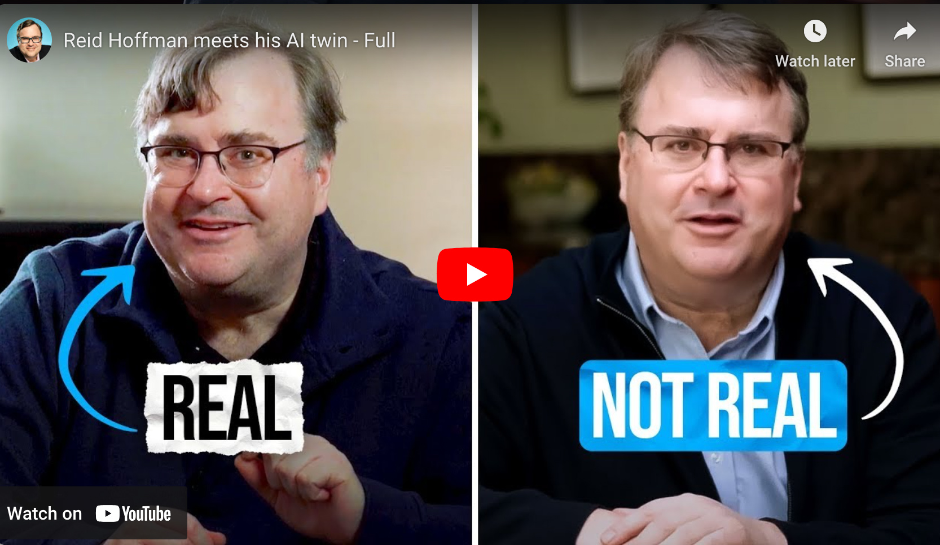
Reid Hoffman meets his AI twin
On SafeShare.TV
On YouTube

Slide 3
Agenda
Topics & resources re: Artificial Intelligence (AI)
A potential, future next-gen learning platform
The powerful impact of pursuing a vision
Share some lessons from my past
The significant impact of an organization’s culture
NOTES:
This presentation can be found out at: danielschristian.com/ETOM
At the end of this presentation, there are several slides for people to check out re: EdTech and Learning Science.

Slide 4
Artificial Intelligence (AI)
Some key topics & resources

Slide 5
What is multimodal Artificial Intelligence (AI)?
AI systems that can process and understand multiple types of data or modes of information
Typically includes text, images, audio, & video; sometimes code
Can reason across multiple media, mimicking what humans do

Slide 6
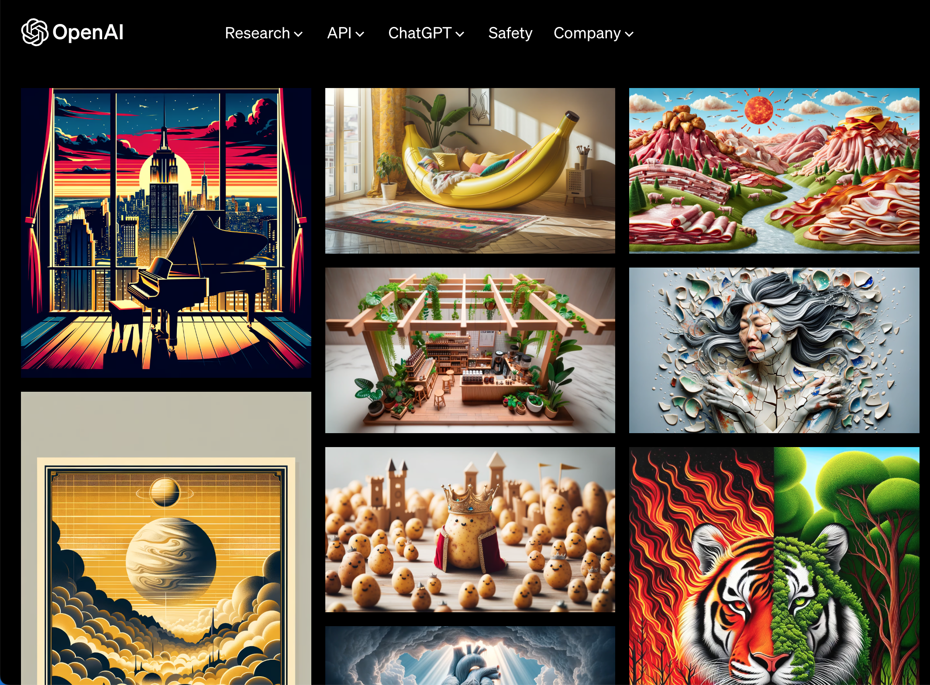
The major multi-modal players: OpenAI
Open AI’s ChatGPT ←as of May 2024 at GPT-4o (o for “omni”)
Popular & widely available AI assistant
Real-time conversational speech/results
23 videos re: GPT-4o
ChatGPT for macOS lets you share screenshots & ask Qs about it
GPT-4o is open to all, including free plans
Dall*E3 for text-to-image
Sora for text-to-video
Try ChatGPT here

Slide 7
The major multi-modal players: Google
Google’s Gemini ← now at Gemini 1.5 Pro; formerly Bard
Powering multiple applications
Project Astra – a real-time, multimodal AI assistant
Veo – video generation model
Imagen 3 – text-to-image model
Try Gemini here.

Slide 8
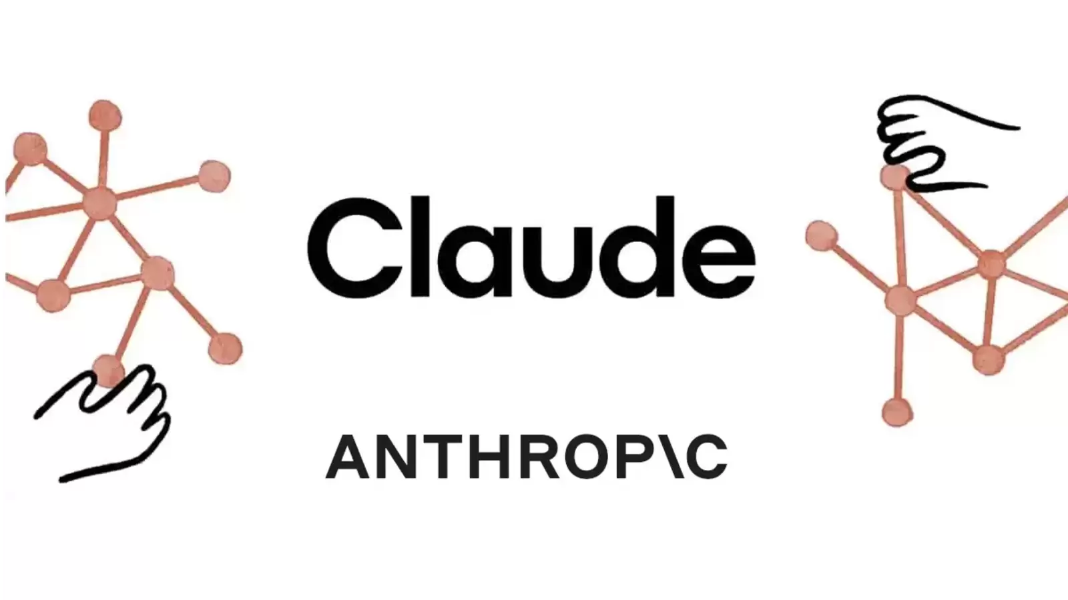
Other major multi-modal players
Microsoft’s Copilot for Microsoft 365 formerly Bing Chat
Runs on GPT-4 & DALL-E 3, excels at coding, text generation
Introduced Copilot+PCs (May 2024)
Try Copilot here
Anthropic’s Claude 3 (trained on data through Aug 2023)
Designed to emulate more human-like responses
Impressive language understanding
Exceptional in generating creative and insightful text
Via tool use, can interact with external tools & APIs
Try Claude here.

Slide 9
Other major multi-modal players
Meta AI
Built with Llama 3 with strengths in handling large datasets
Open-source model with mobile device integration
Understands what’s in an image & what people are asking of it
Can use on Facebook, Instagram, WhatsApp, & Messenger
Try Meta AI here
Perplexity
Easy-to-use alternative to traditional search engines
Always up-to-date, in real-time
Conversational style – can understand context, nuances
Clear, concise, accurate, & informative content – with citings
Just released Pages – educators, researchers, hobbyists
Try Perplexity here.
Notes:
s

Slide 10
…for learning about AI
Resources…

Slide 11
Resources for learning about AI
The Neuron by Pete Huang & Noah Edelman
Newsletter
Podcast
The Rundown AI
Links to articles
Step-by-step guides
Tools
AI jobs
AI & tech news

Slide 12
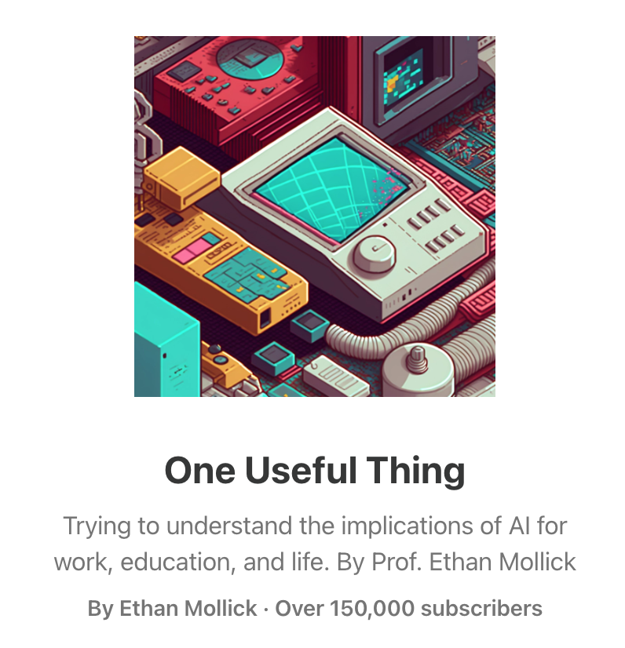
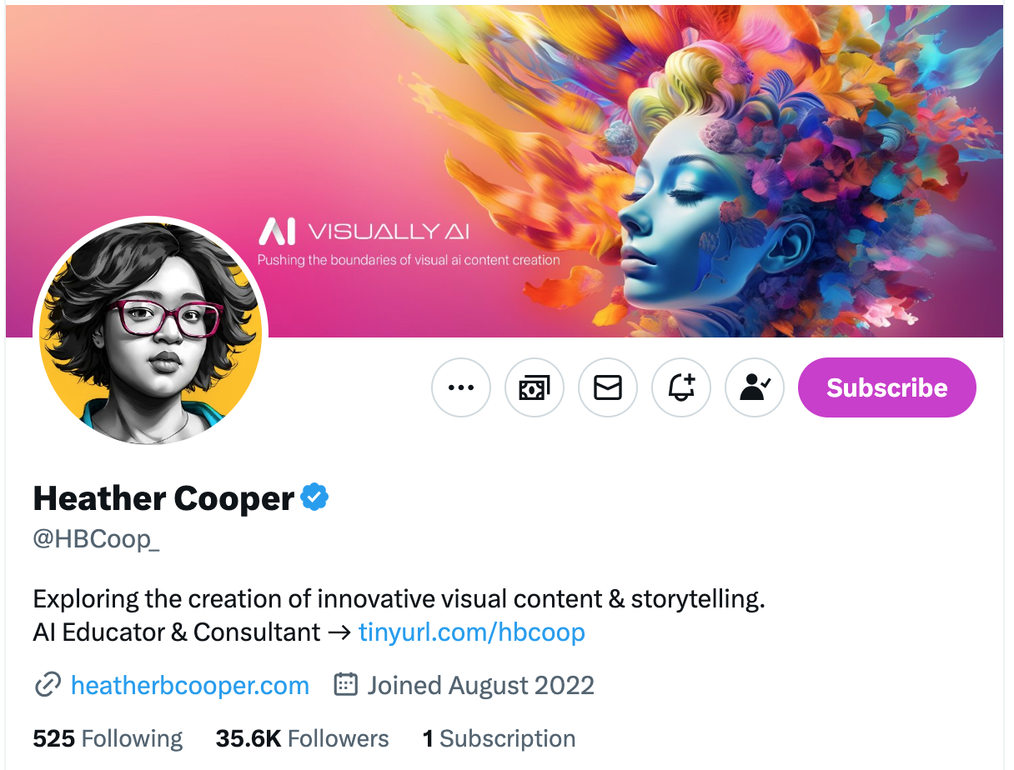
Resources for learning about AI
Ethan Mollick Wharton (U of Penn) Associate Professor of Mgmt Academic Director, Wharton Interactive
Heather Cooper: Visually AI Newsletter Tools, techniques, vendors, and individuals who focus on visual content and storytelling

Slide 13
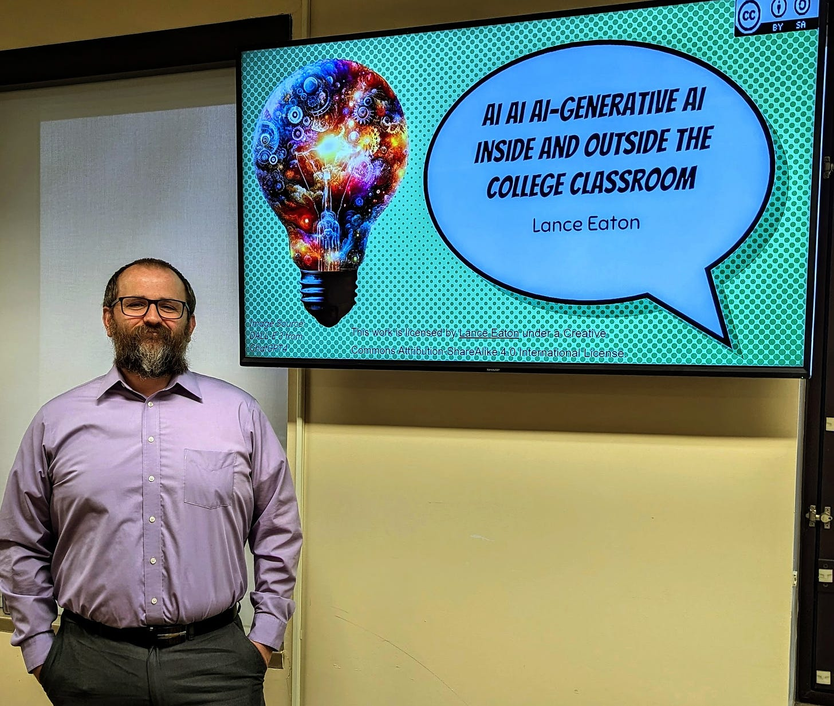
Resources for learning about AI
Lance Eaton AI + Education = Simplified Focus on HE
Zain Kahn Superhuman AI

Slide 14
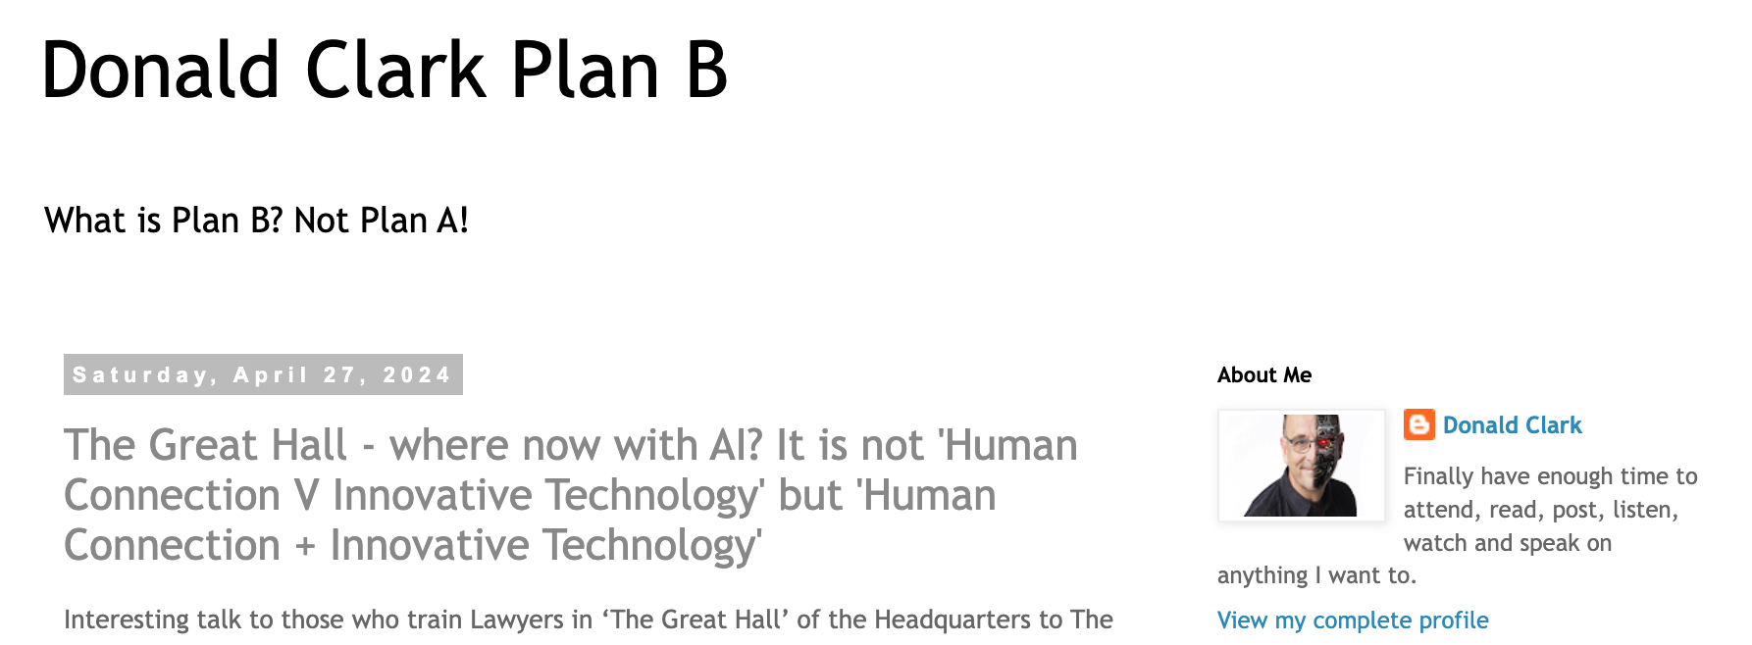
Resources for learning about AI
Donald Clark Plan B
Tom Barrett Promptcraft e-newsletter Blog focuses more on ed & edtech

Slide 15
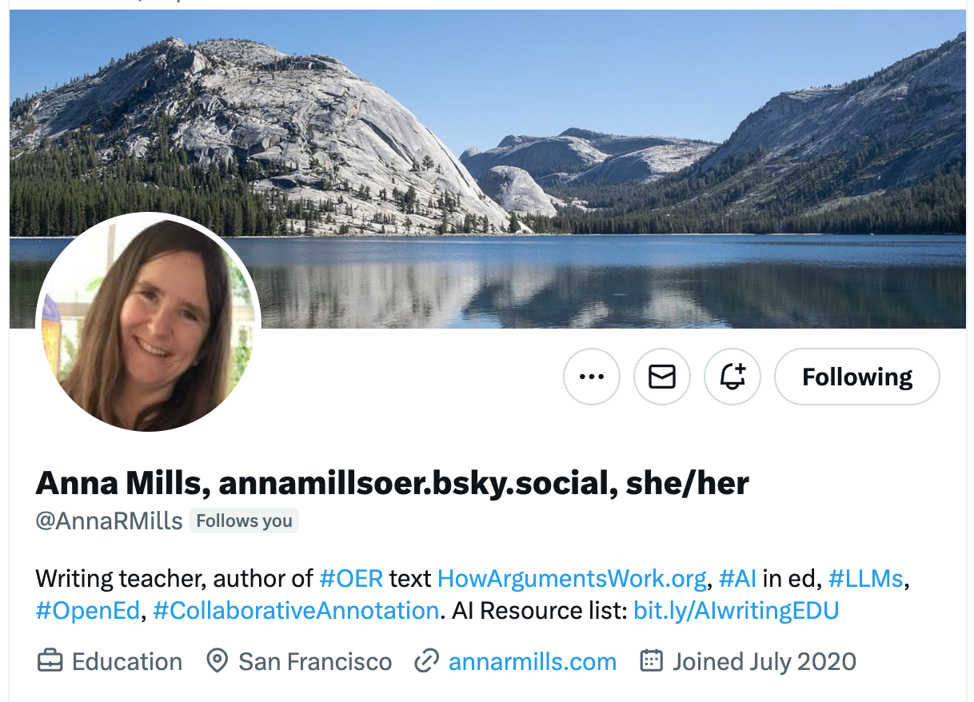
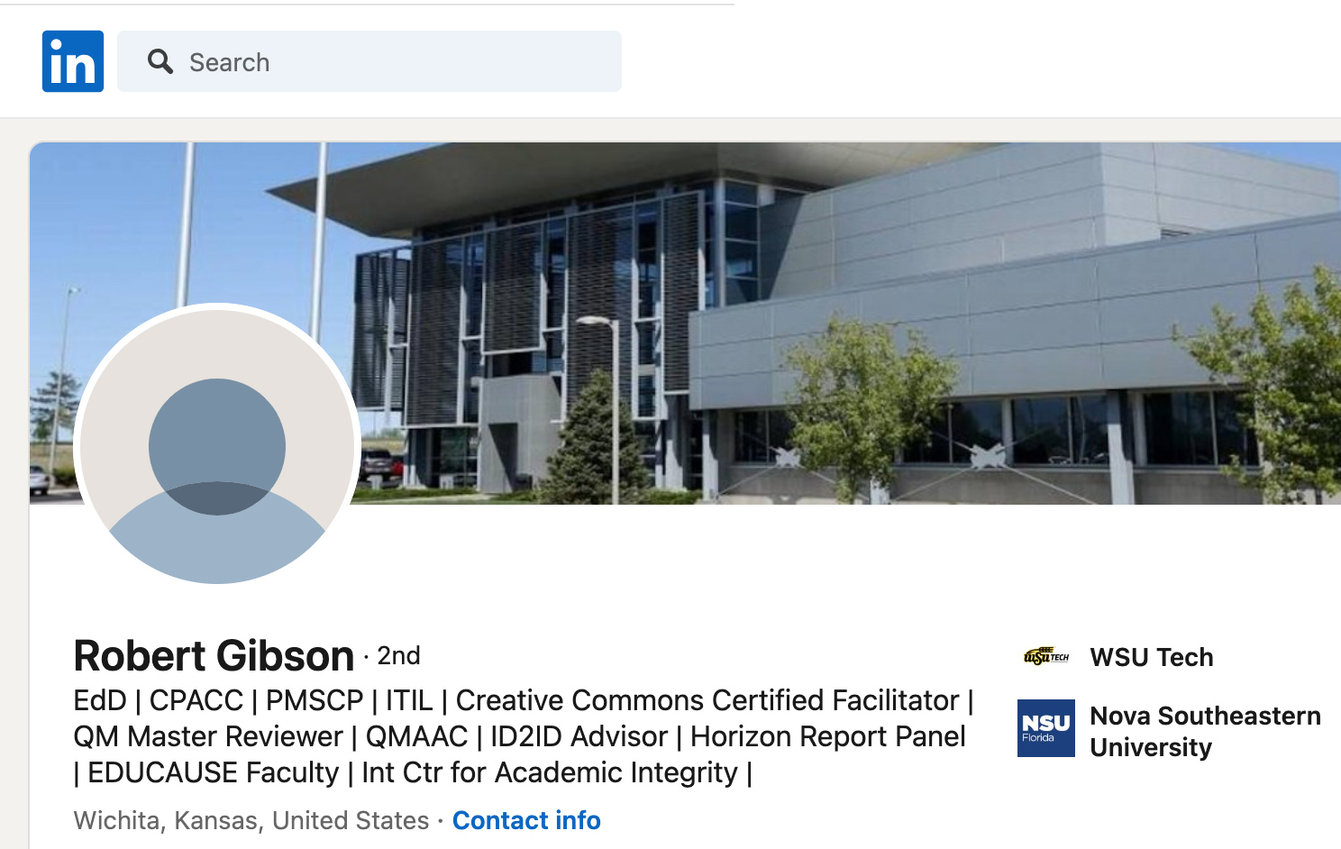
Resources for learning about AI
Anna Mills – Writing teacher Website | Twitter
Robert Gibson
LinkedIn Dean, ITAS & Dir of Instructional Design

Slide 16
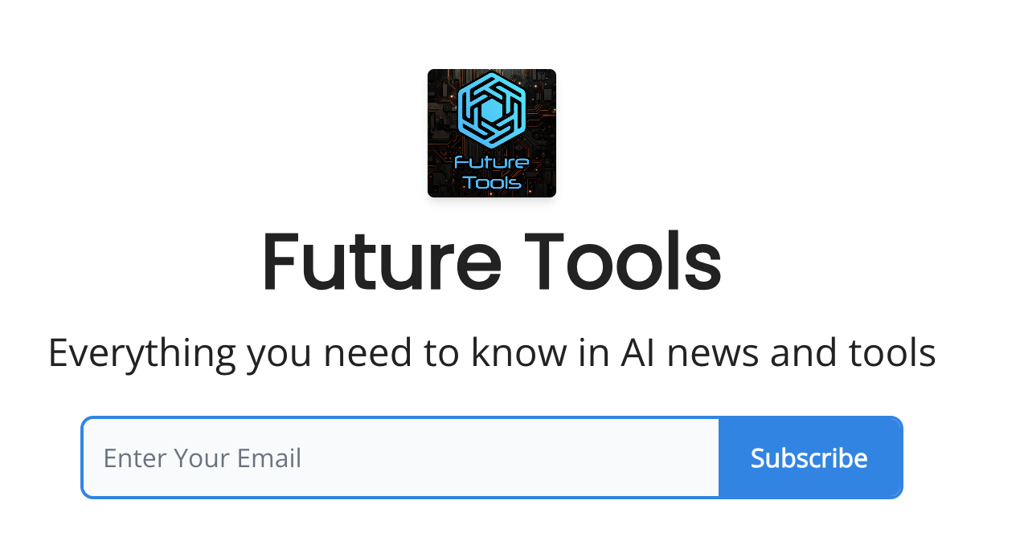
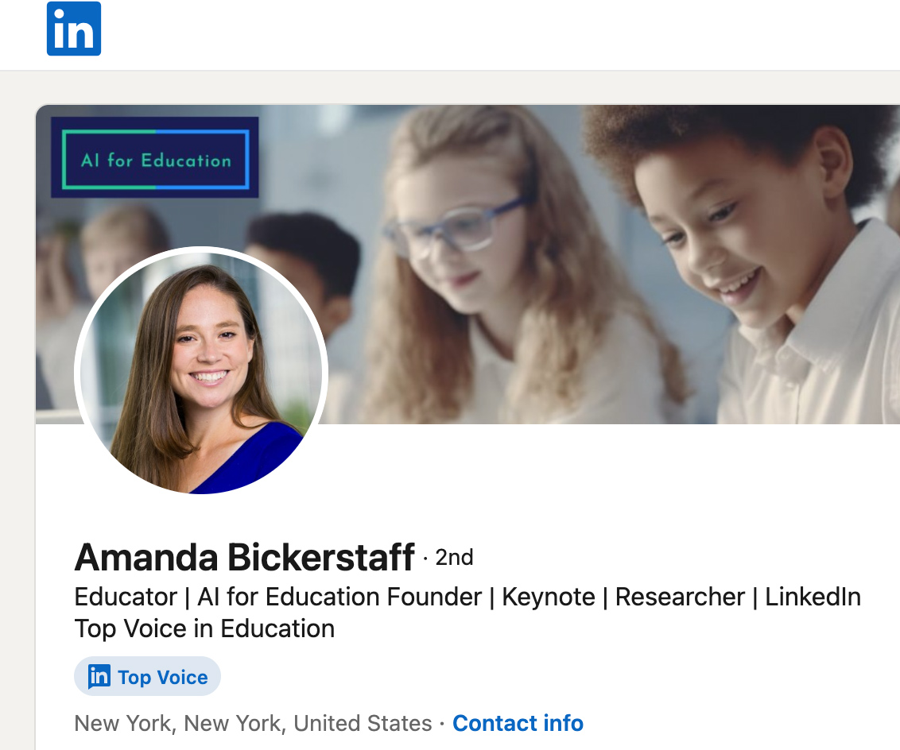
Resources for learning about AI
Amanda Bickerstaff Founder/CEO AI for Education
Matt Wolfe: Future Tools

Slide 17
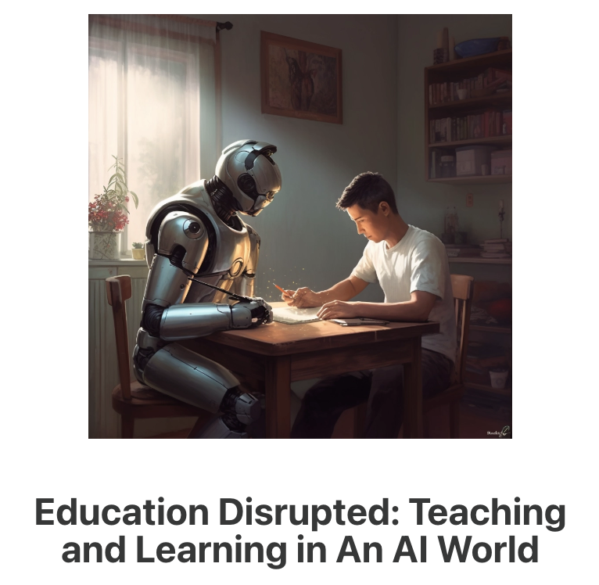
Resources for learning about AI
Dr. Philippa Hardman
Ideas & pedagogies
Science of learning
Impacts of AI
Learning Experience Design
Stefan Bauschard
Machine Learnings – by Sam DeBrule and Brendan Langen
Rhetoria – by Marc Watkins

Slide 18
Resources for learning about AI
Ben’s Bites
AI Valley
Nathan Benaich & Co. State of AI
Allie K. Miller Twitter | AI with ALLIE blog

Slide 19
Resources for learning about AI
Technological trends
Finding appropriate uses for AI-enabled technology
Supporting AI fluency
…and more

Slide 20
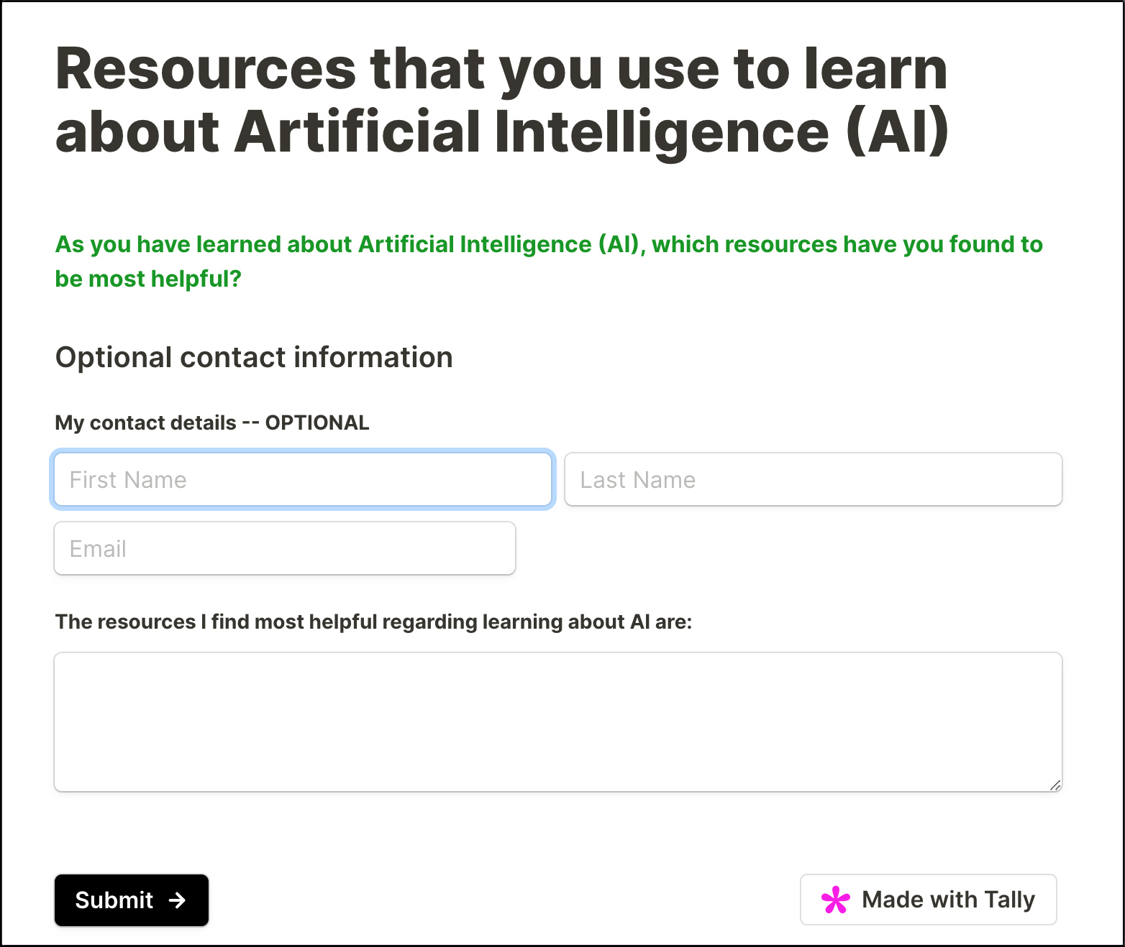
What are YOUR resources for learning about AI?
Please take a moment to complete the form listed on the web page at:
danielschristian.com/ETOM
Form #1
I will gather the entries and send them to Garry so that he can distribute them back to you all.

Slide 22
Applications of AI: AI created video
On SafeShare.TV
On YouTube

Slide 23
Applications of AI
Ability to produce or create text, audio/speech, images, music
Text-to-speech (ex: ElevenLabs)
Text-to-image (Adobe Firefly, Open AI’s DALL-E 3, Stable Diffusion, Midjourney, Microsoft’s Copilot Designer, Google DeepMind’s Imagen 3)
Text-to-video (ex: AI Studios, synthesia)
Text-to-music (ex: Snapmuse, Stable Audio, Suno)

Slide 24
Applications of AI
AI writing tools/text editing
Grammarly
Microsoft Word Copilot
AI within Google Docs
Lex
Wordtune
Stylebot
Numerous others
AI voice generators/voiceovers
ElevenLabs
ElevenLabs > Turn your voice into passive income. Share your voice in the Voice Library today and earn cash rewards when it's used.
Canva
AI music generators
Udio
Canva

Slide 25
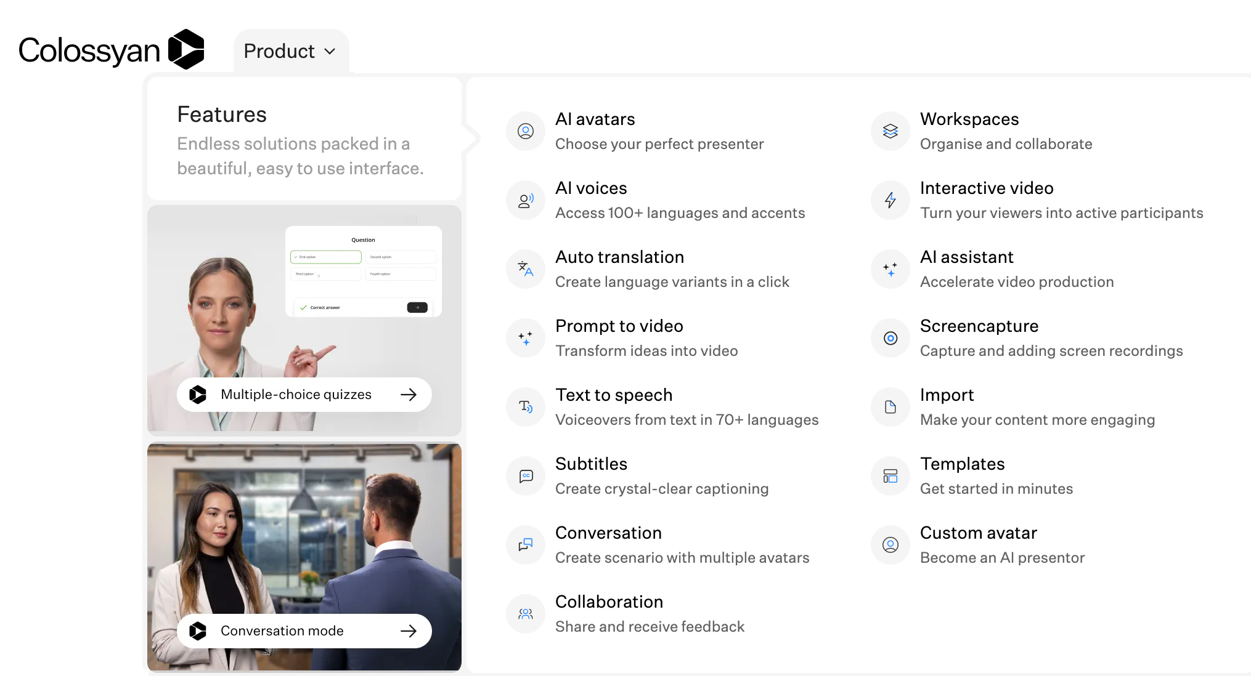
Colossyan: “The AI video platform for workplace learning”

Slide 26
Applications of AI
Answer questions
Write code
Write emails, blog posts, articles, essays
Generate designs for graphics, logos, product prototypes
Generate ideas/brainstorming
Aid with developing a solid resume
Create simulations

Slide 27
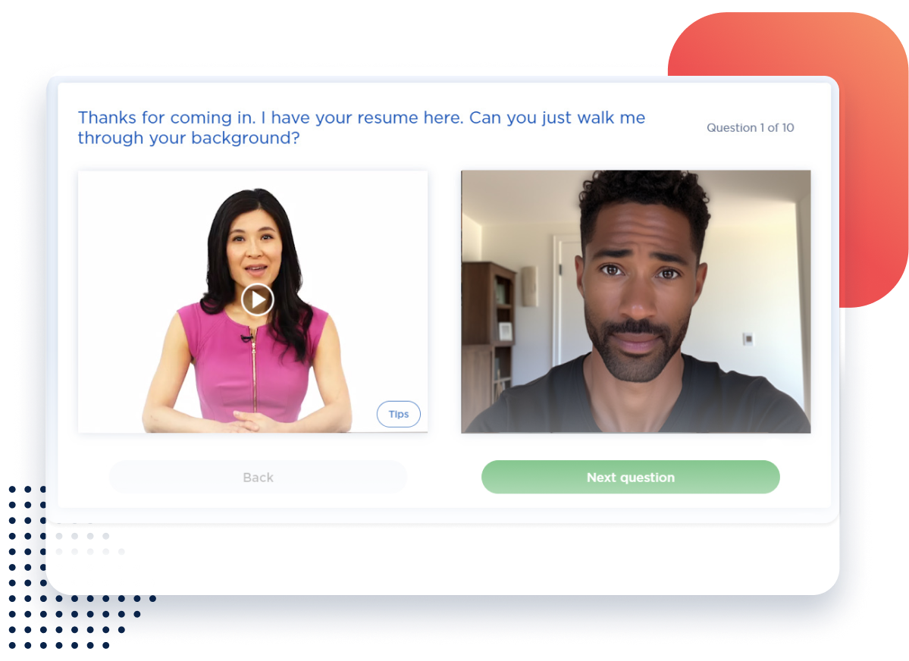
Applications of AI
Learning-related
Mock interviews/role-playing
Personalize learning (more later)
Aid with developing interactive training
Develop content
Explore new topics
Research products
Increase accessibility via automatic image descriptions & transcripts
Automatic language translations
Helpful with content localization

Slide 28
Applications of AI
Game development; plus personalized gaming experiences
Aid with vacation planning
Help with cooking – including finding recipes
Assist with fitness training

Slide 29
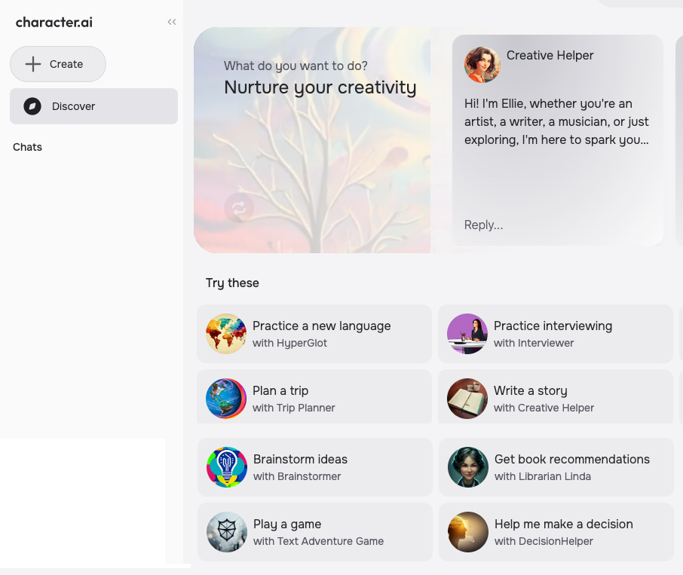
Applications of AI
character.ai
Notes:
asfd

Slide 30
Applications of AI
How a Hollywood Director Uses AI to Make Movies
AI comes to filmmaking — from Bloomberg AI Film Festival
2023: 300 videos submitted
2024: 3,000
100’s of filmmakers, techies, artists, venture capitalists and actors/actresses

Slide 31
Applications of AI
Medical imaging analysis
Interpret a patient’s medical history along with imaging data (x-rays, ultrasounds, radiography) to detect patterns & diagnose diseases
Machine learning models can be used to predict consumer behavior, target advertisements, and monitor user behavior
Platforms can create personalized recommendations based on user preferences and behavior

Slide 32
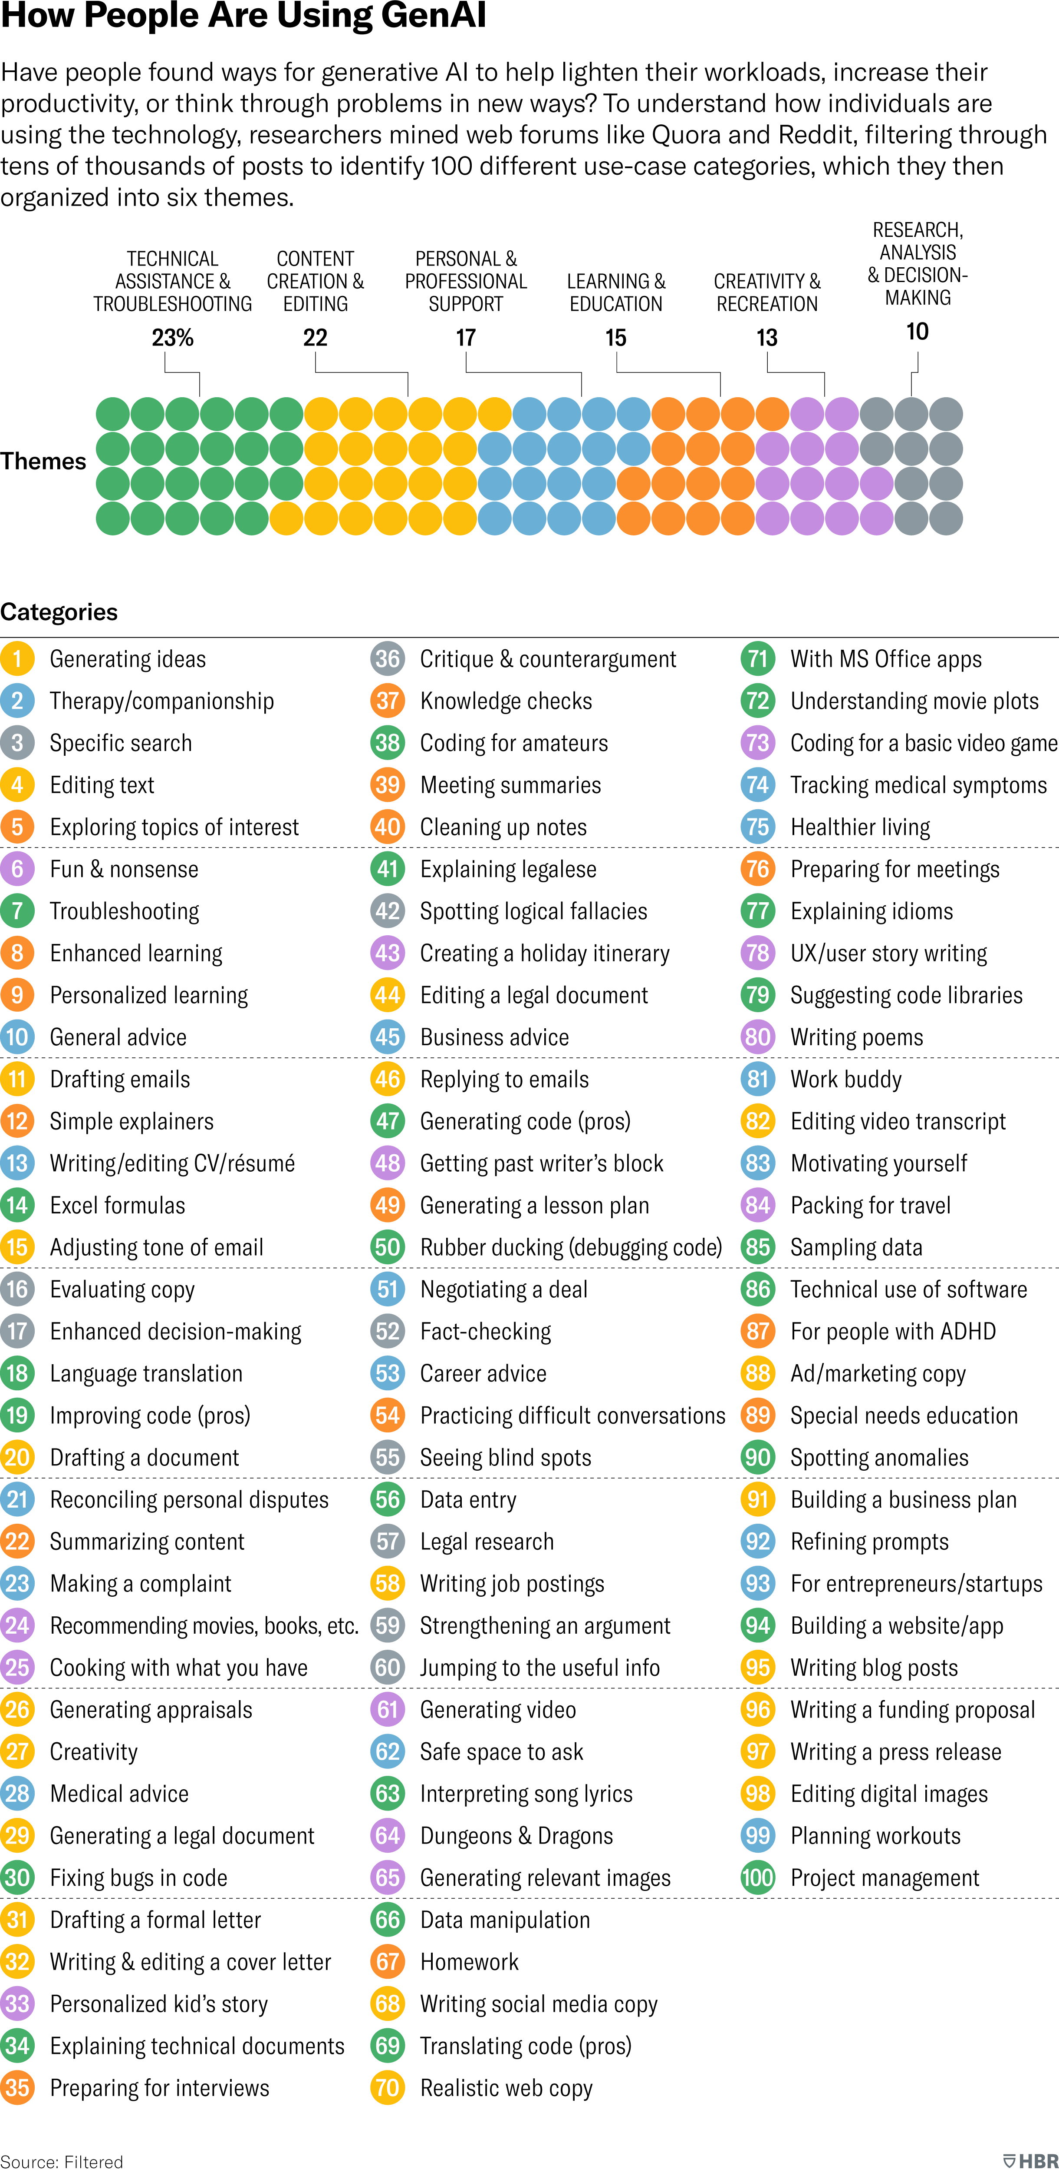
Applications of AI
How People Are Really Using GenAI From HBR.org by Marc Zao-Sanders
Technical Assistance & Troubleshooting (23%)
Content Creation & Editing (22%)
Personal & Professional Support (17%)
Learning & Education (15%)
Creativity & Recreation (13%)
Research, Analysis & Decision Making (10%)

Slide 33
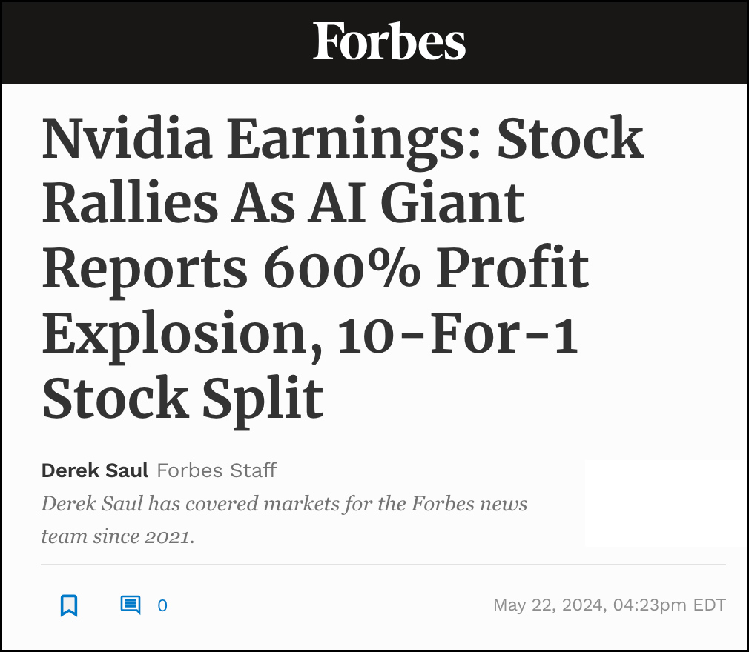
Examples from the hardware/infrastructure side of AI
NVIDIA designs the favored chips for training AI systems
Supplying the shovels for the AI Gold Rush
2.82 TRILLION $$ market cap (5/30/24)
Explosive growth – esp w/ data centers
Many large tech co’s are customers
Smartphones likely the key for combining the physical world w/ digital world
Apple is working with OpenAI (source)
Wearables & small mobile devices
Rabbit R1
Ray-Ban Meta Smart Glasses

Slide 34
Usage of AI
The Verge: What’s Next With AI Feb 2024 Consumer Survey
Methodology In December 2023, the Vox Media Insights and Research team surveyed more than 2,000 consumers with our partner, The Circus. The Circus is an insight and data storytelling consultancy that specializes in original trend research, thought leadership, and strategic brand positioning rooted in a human-data centric approach.

Slide 35
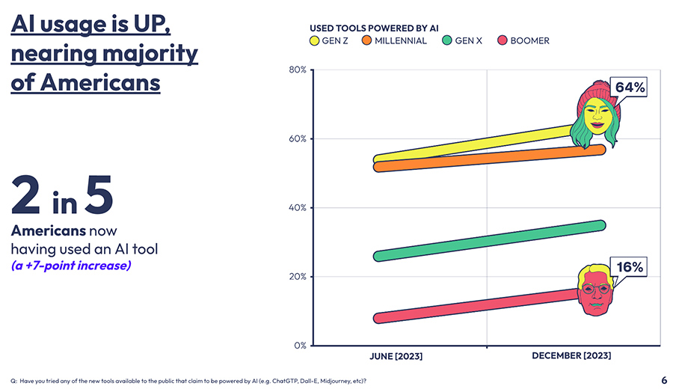

Slide 36
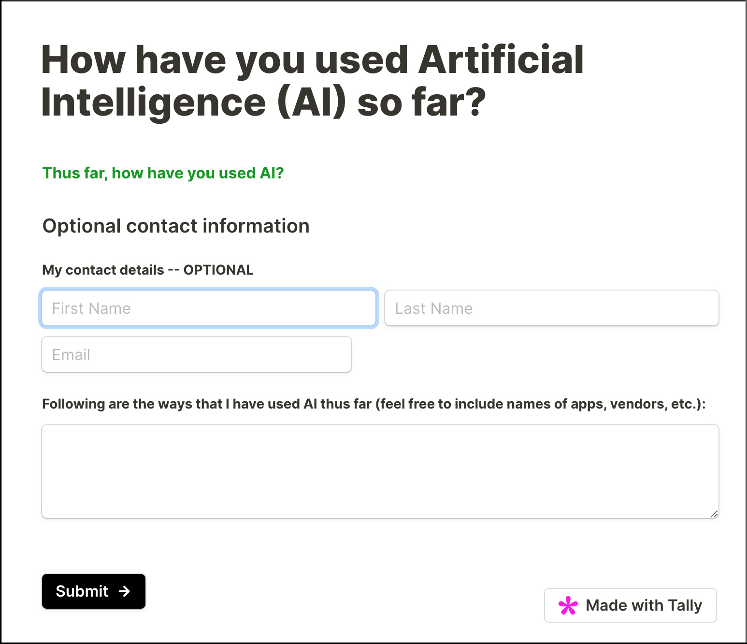
How have YOU used AI so far?
Please take a moment to complete the form listed on the web page at:
danielschristian.com/ETOM
Form #2
I will gather the entries and send them to Garry so that he can distribute them back to you all.

Slide 37
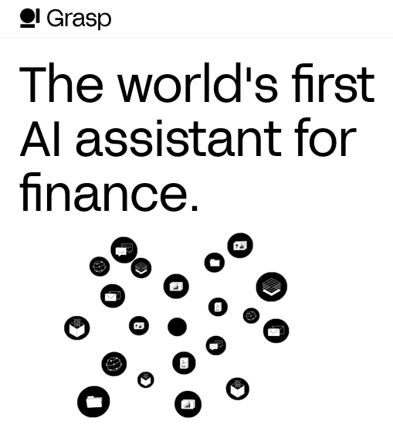
My predictions re: AI
An enormous # of apps will combine the physical with the digital – esp. re: wearables & smartphones
LLMs/SLMs will continue to grow in their knowledge & reasoning abilities
More industry-specific AI-based assistants
Healthcare
Education
Banking/finance
Legal
Etc.

Slide 38
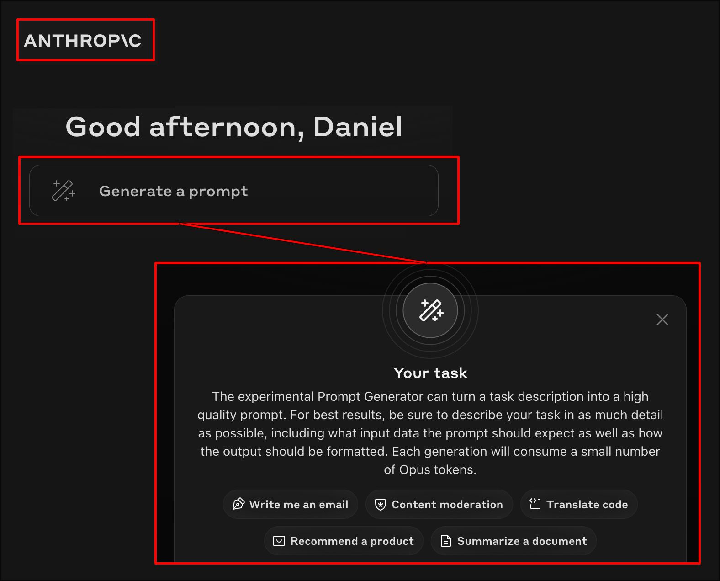
My predictions re: AI
Further integration with robotics
Prompt engineering will fade away or (at minimum) user can choose to have prompt assistance
Increasingly integrated into all kinds of apps
Like OpenAI’s ChatGPT desktop app for macOS (incl. screenshots)
Ability of assistants to know what you’re working on

Slide 39
My predictions re: AI
Even more personalization in retail, entertainment, & consumer-facing industries
Uses will be both positive and negative
But issue here is the enormous POWER of AI – such as deepfakes, facial recognition
Will continue to impact the legal field in significant ways
More people will use AI for mental health assistance
More nursing homes will help elderly people use conversational bots for company

Slide 40
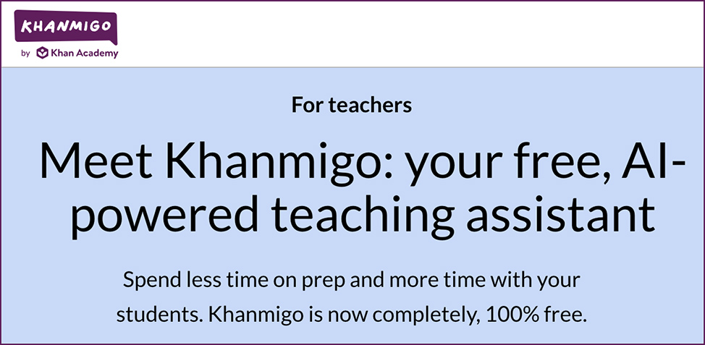
My predictions re: AI
Better personalized/customized learning (more later)
More tools/uses for teachers & faculty members
Like Khanmigo for Teachers
Devise lesson plans, formulate Qs about assigned readings, generate reading passages, develop quizzes & assignment instructions, thought starters
Build a course website – or a series of modules -- from a syllabus
Curate content
Create assessments
Increased integration with LMSs/CMSs

Slide 41
Generative AI – An insightful quote from David Wiley
“Just as instructional designs had to be updated to account for all the changes in affordances of online learning, they will need to be dramatically updated again to account for the new affordances of generative AI.”
Source > David Wiley

Slide 42
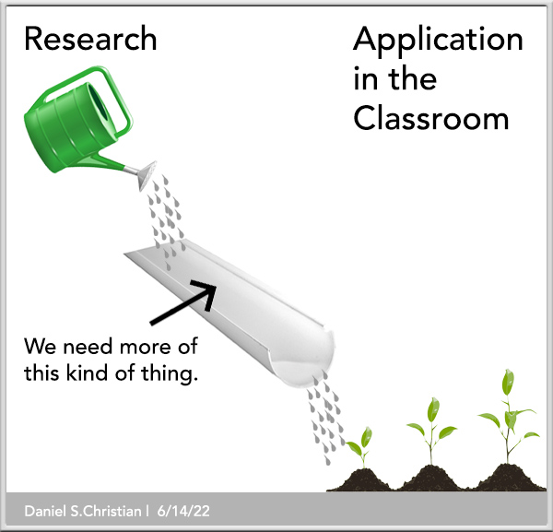
We need further research re: AI and then to integrate that research into our classrooms.

Slide 43
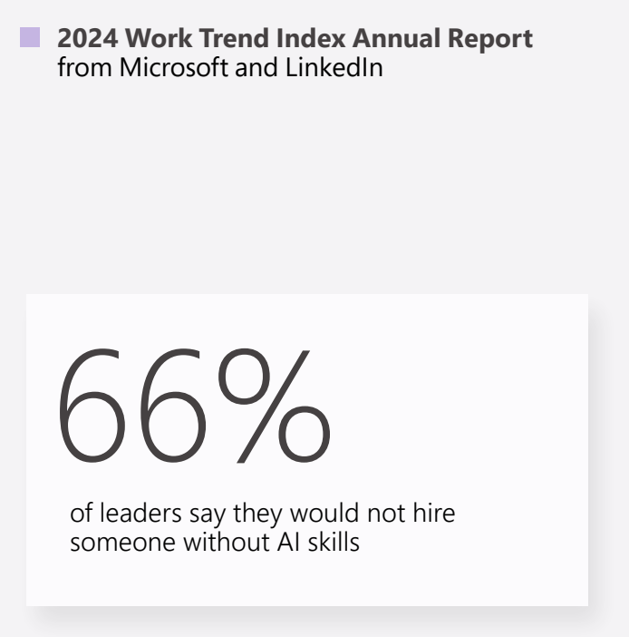
Brief small group breakout – 5 minutes
As we look to our students’ futures – and their co-existence with AI – what questions should we be asking? Which topics should we be addressing?
How is your organization handling AI?
With the exponential pace of change and employers wanting people with AI skills, where does AI stand on your campus?
Is it working on preparing students for leveraging AI or is it shutting AI down?

Slide 45
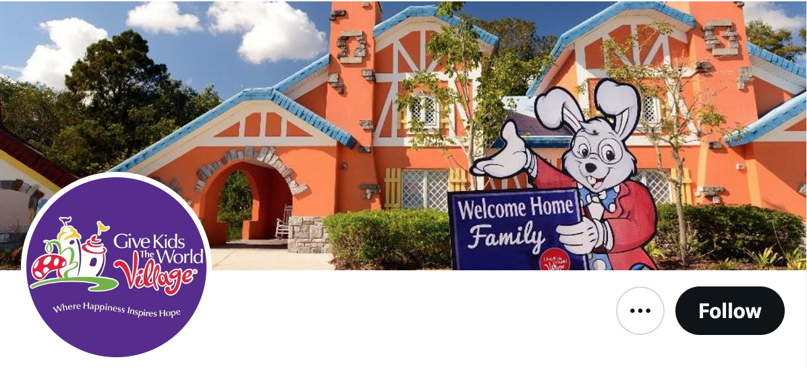
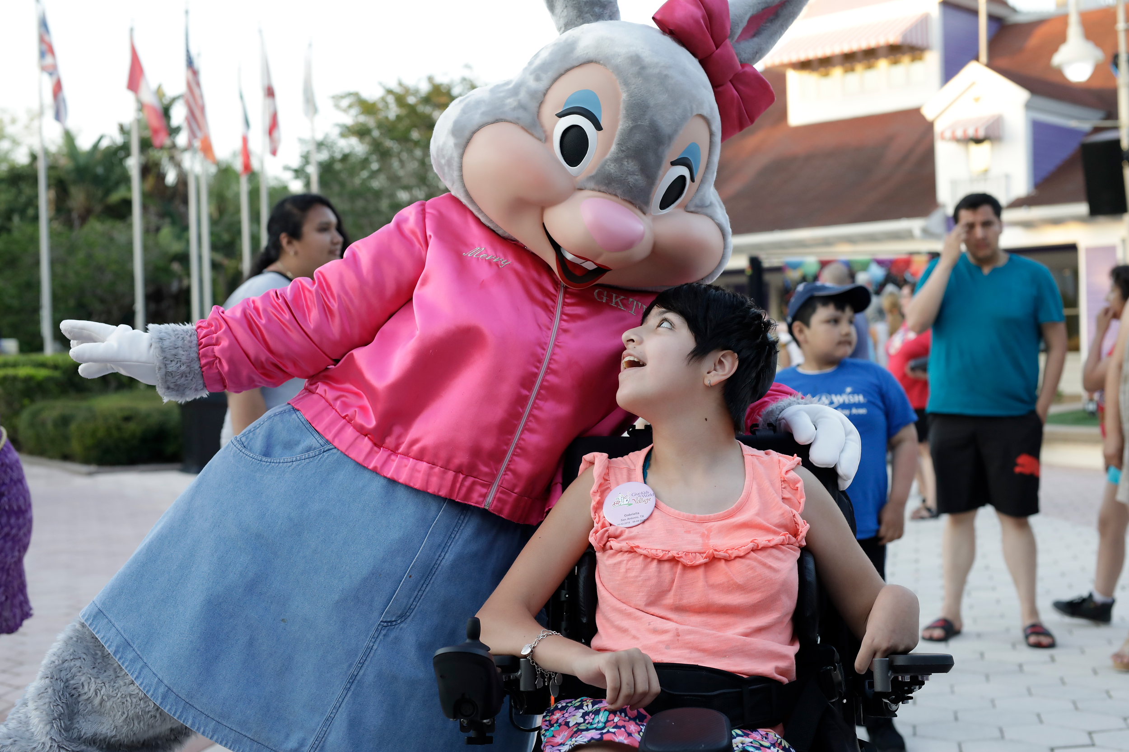
The power of a vision!
No time to reflect on how Steve Jobs, Elon Musk, Walt Disney, and other visionaries changed our world!
But back in January, we served at the Give Kids the World Village

Slide 46
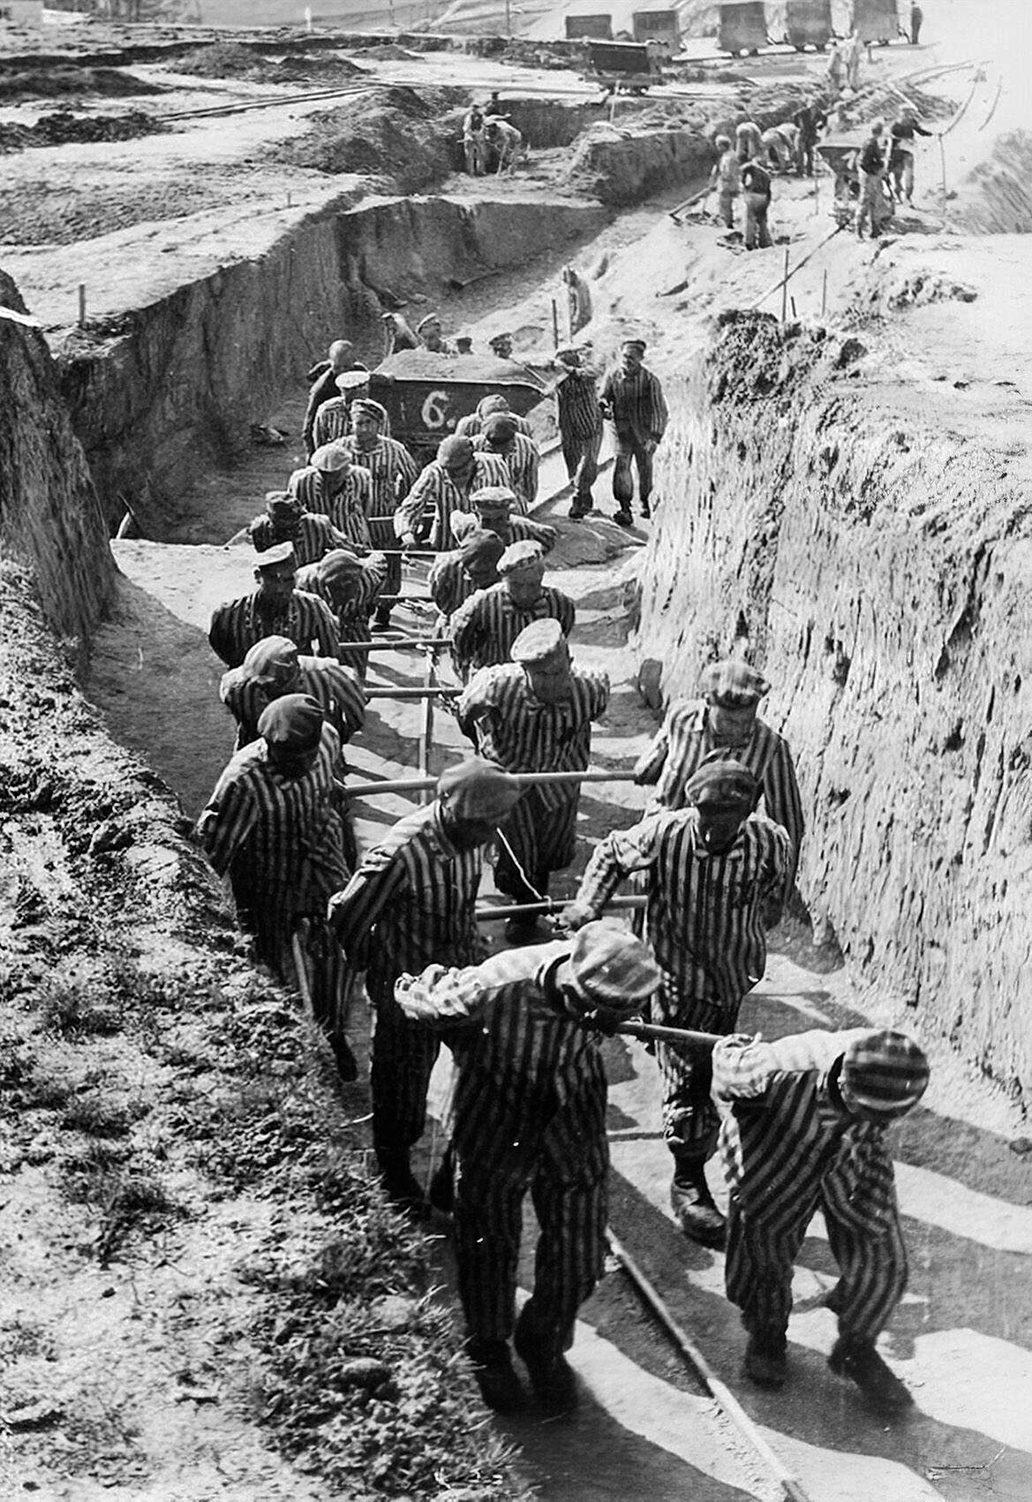

Slide 47
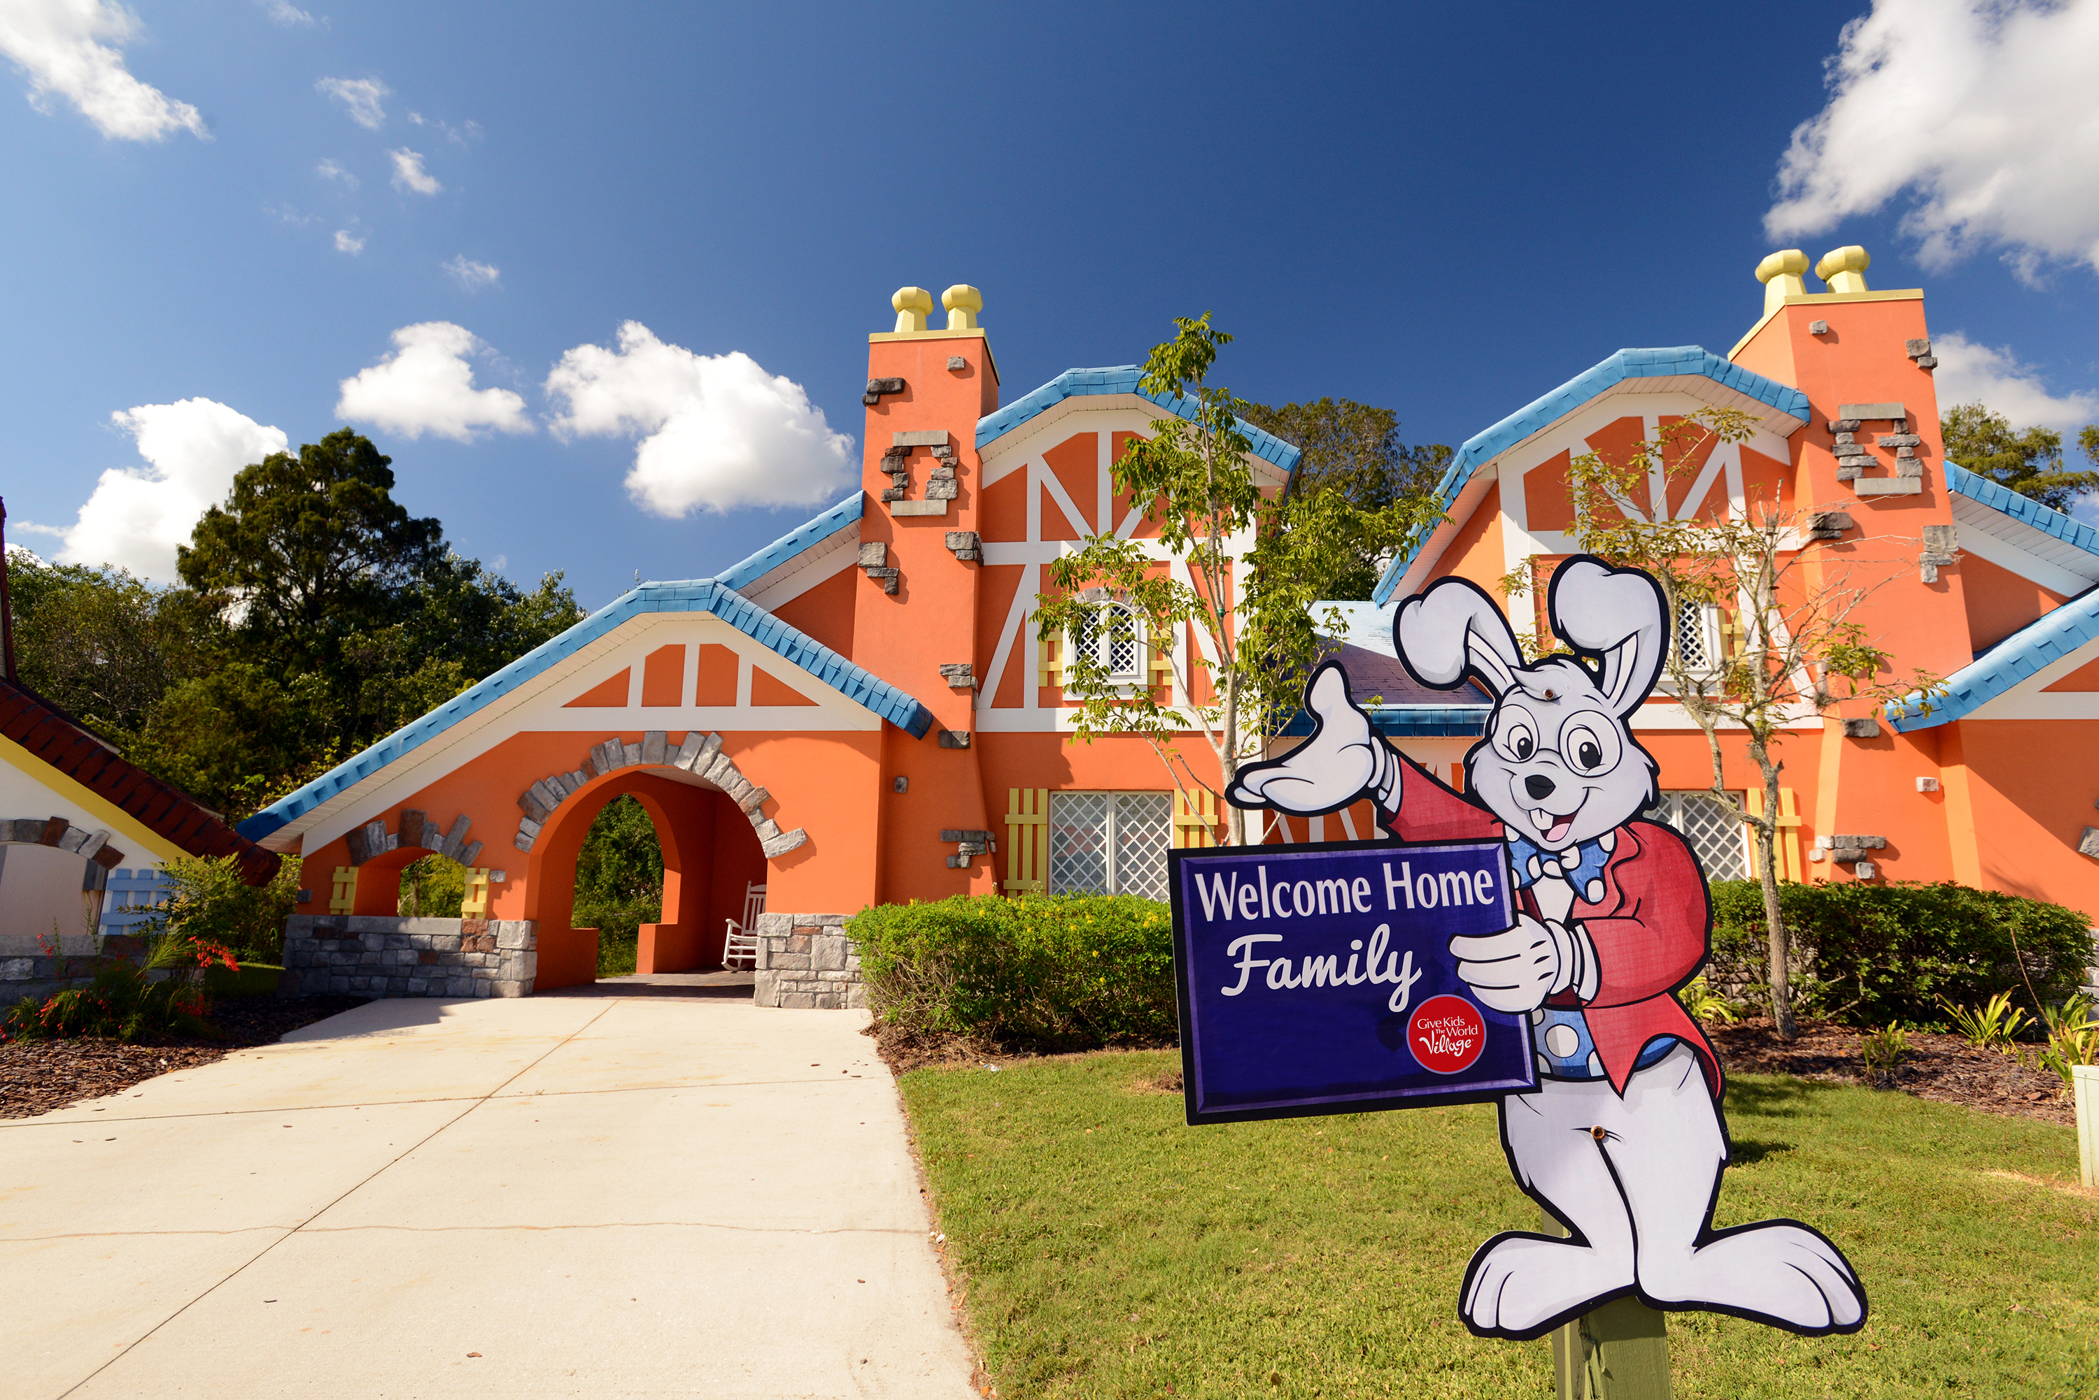
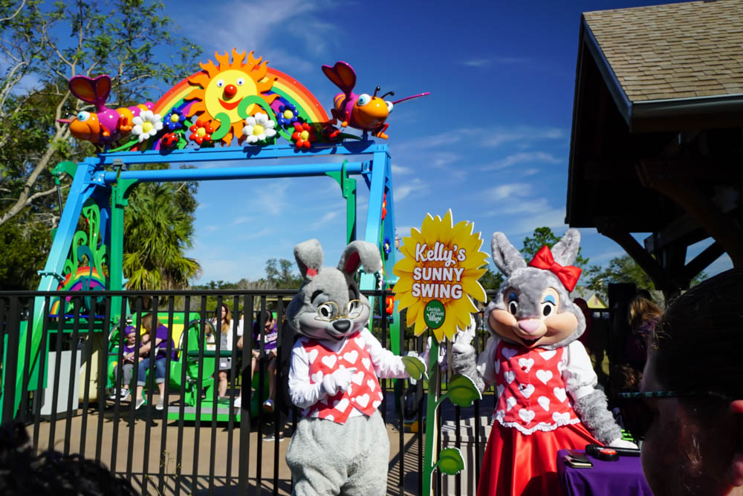
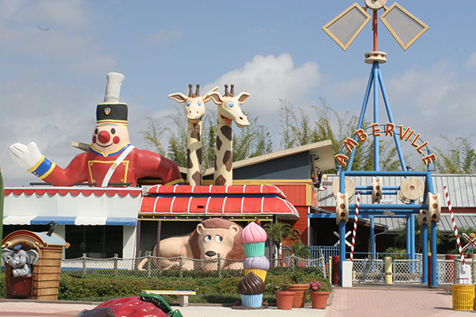
Notes:
Since 1986, the Give Kids The World Village has welcomed more than 188,000 families from all 50 states and 77 countries.

Slide 48
Lessons from the corp world: The power of a vision!
Questions to reflect upon later on:
What vision is your organization pursuing? Can you and other employees articulate it?
Do you know where you fit in in regards to realizing that vision?
Are there any obstacles to you, your group, or your department in realizing it?

Slide 50
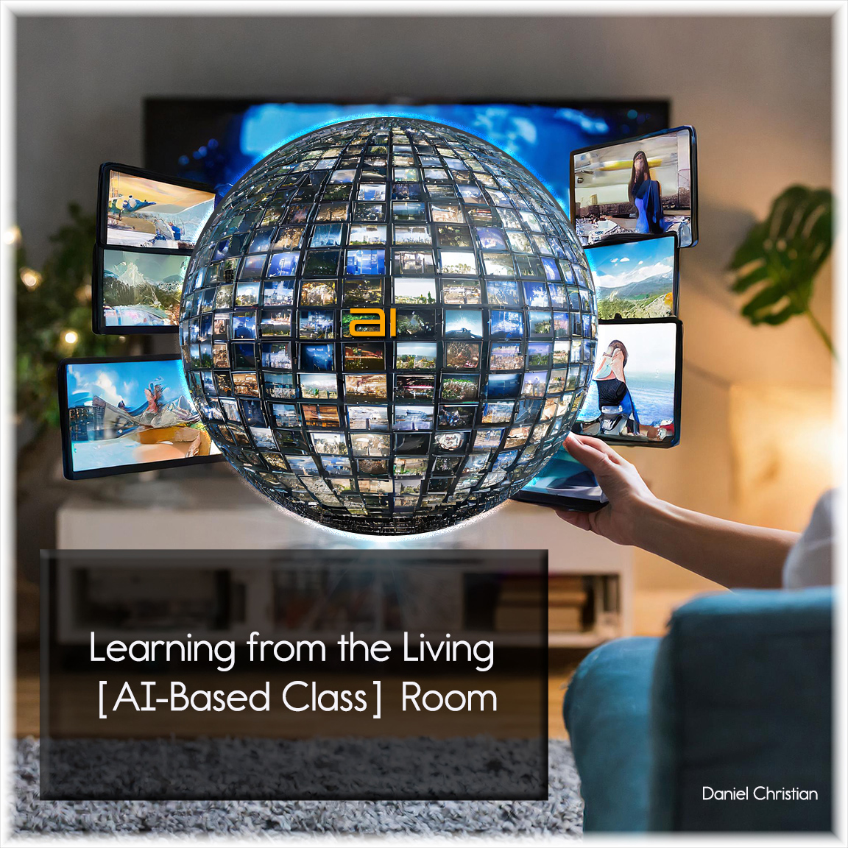
Learning from the Living [AI-Based Class] Room
"I've been predicting that by 2030 the largest company on the internet is going to be an education-based company* that we haven't heard of yet," Frey, the senior futurist at the DaVinci Institute think tank, tells Business Insider.
Thomas Frey – Business Insider – 12/27/16
* DC: Whoever creates this next-gen learning platform.

Slide 51
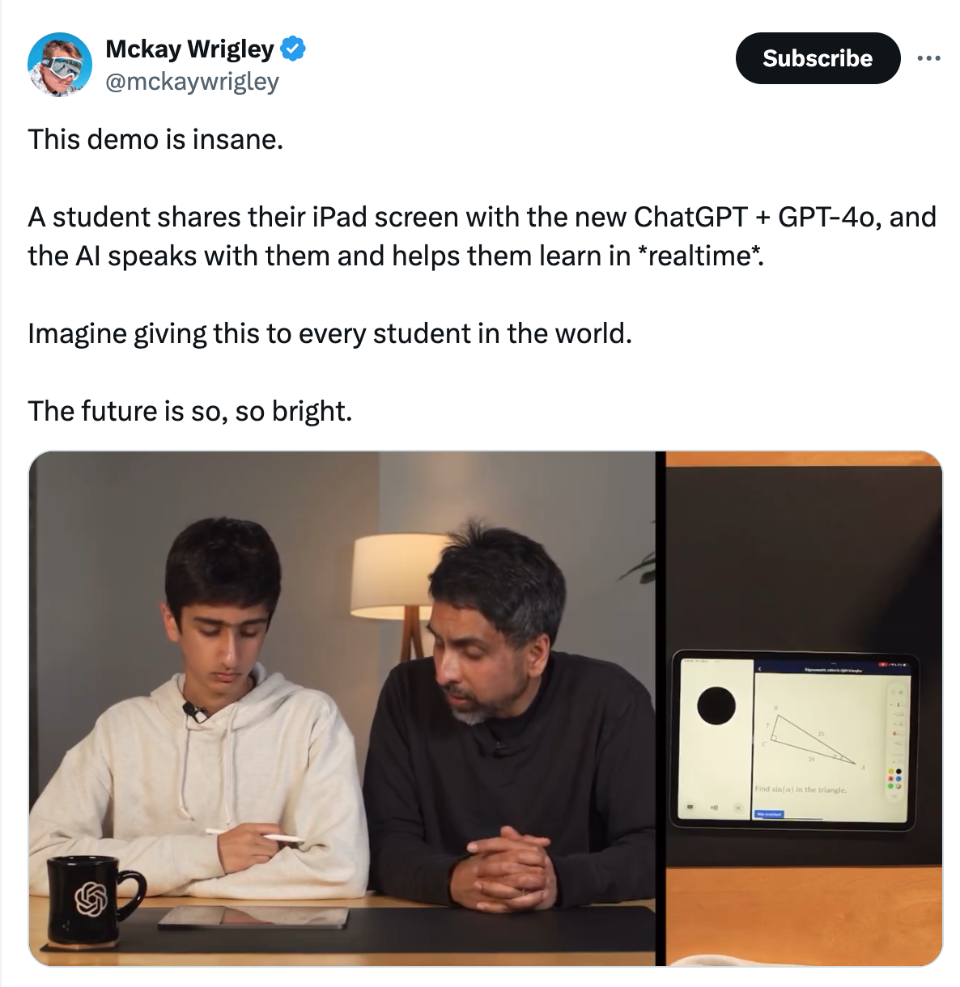
Learning from the Living [AI-Based Class] Room
On SafeShare.TV
On YouTube

Slide 52
Attributes of this next-gen learning platform
Powerful & global
Online-based marketplace will help employers find employees
Promotes continuous, lifelong learning & skills development
Meant to help people reinvent themselves quickly & cost-effectively
Will require human beings
Many opportunities for social/ collaborative-based learning
AI will constantly provide up-to-date curricula
Focused on marketable skills
But also, items for the joy of learning

Slide 53
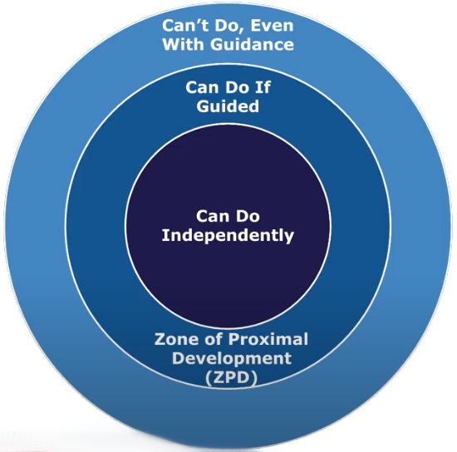
Personalized/customized learning
Learning agents will be able to identify & remember one’s Zone of Proximal Development (ZPD)
Greater access to quality education & training
Available 24x7
Instant feedback for students

Slide 54
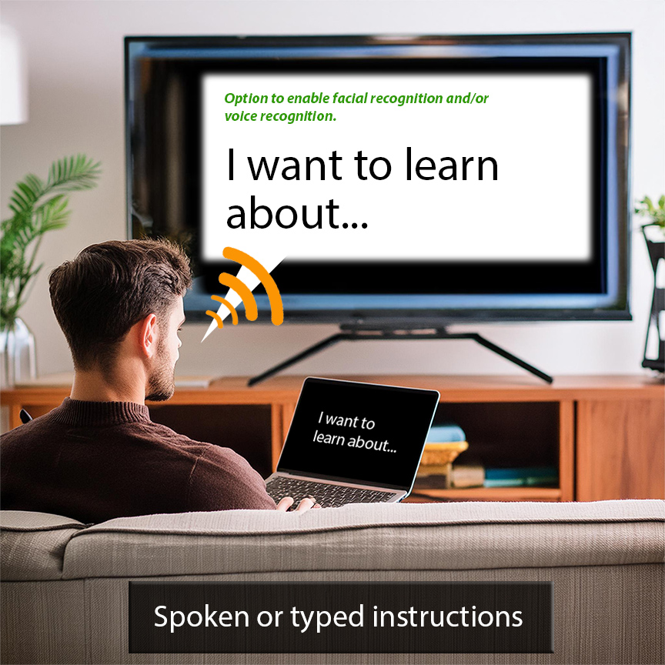

Slide 56
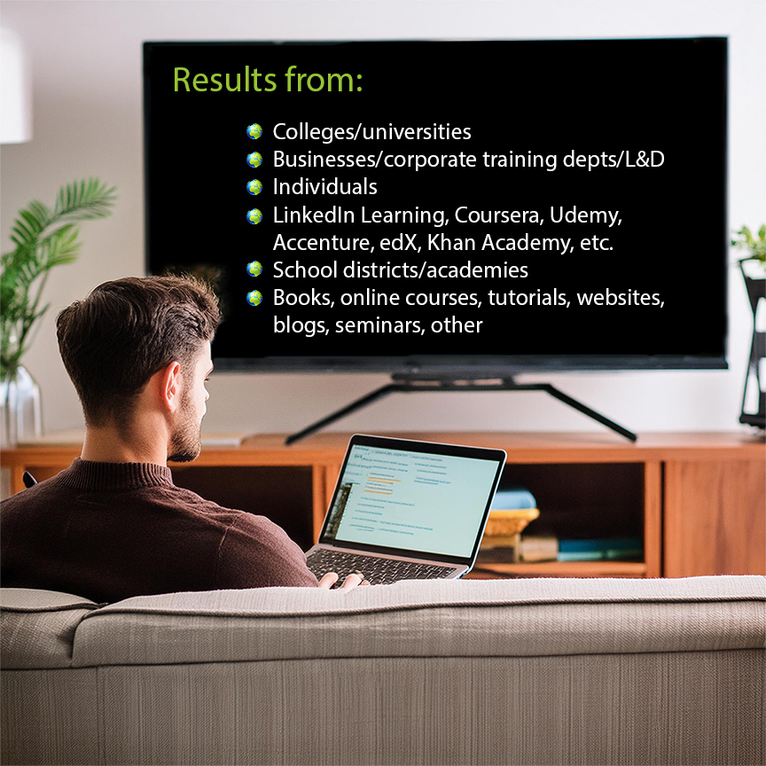

Slide 57
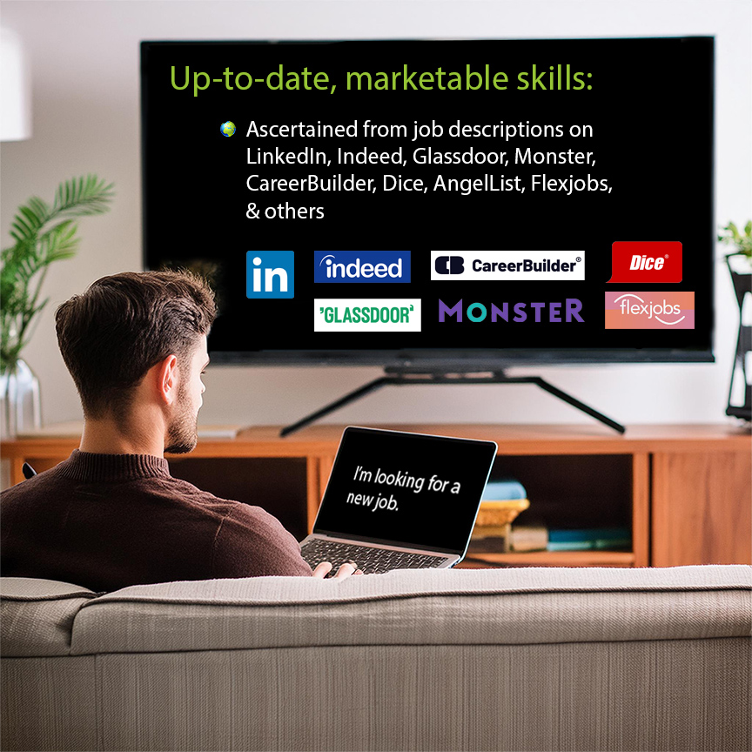

Slide 59
People are key!
In fact, it would be great if the platform could provide the sign-up capability of meeting face-to-face (F2F) with local people to form a study group.

Slide 60
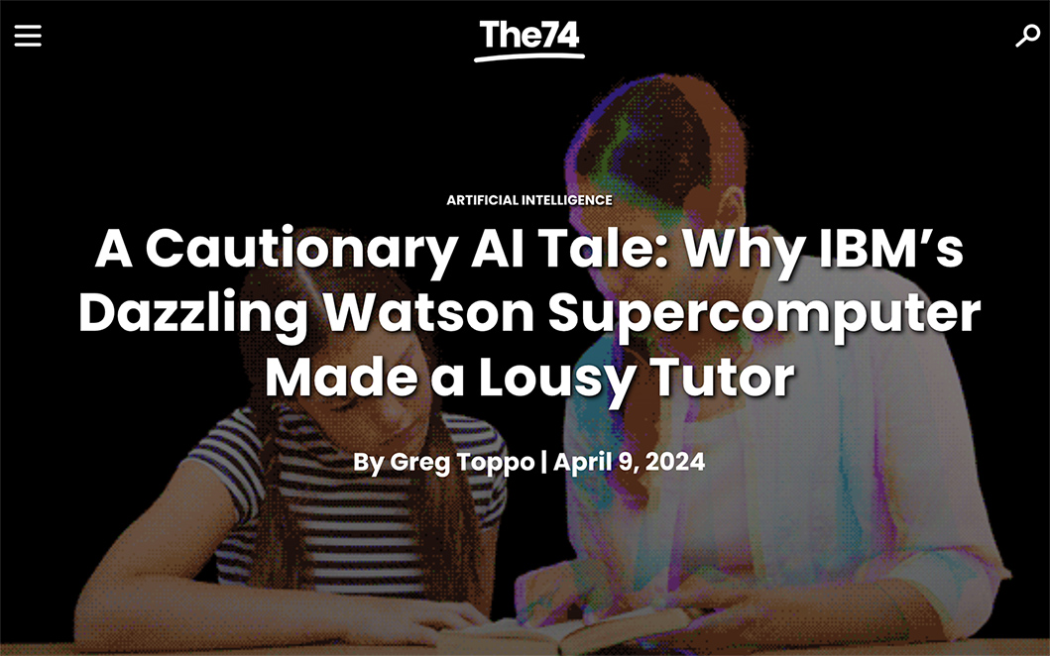
Learning from the Living [AI-Based Class] Room
“We missed something important. At the heart of education, at the heart of any learning, is engagement. And that’s kind of the Holy Grail.”
Satya Nitta, IBM Watson Research Center -- Source
Humans will be needed to engage & inspire other humans -- to keep them focused & motivated.
A blended intelligence approach seeks to harness the complementary strengths of humans and machines

Slide 61
Each of us will own our own learning-related records
We will be able to say when someone can access our learning-related records – and which ones they can access.

Slide 63
Brief notes on preparing our students to enter the workforce
Coming out of high school/college, I wish I knew more about:
The power of – and benefits of – networking and had developed the skills to do it
How to find a job – developing a solid resume, dealing with Applicant Tracking Systems
Financial planning – including doing my taxes
Basic legal-related items
What realistic career paths and expectations look like
The importance of an organization’s culture (more later)

Slide 64
Brief notes on preparing our students to enter the workforce
Questions for you to reflect upon soon:
Are your students knowledgeable and/or skilled in these areas?
If not, does your organization provide seminars/courses to address these things?

Slide 65
From the 30,000-foot level
Half of career at Fortune 500 companies
Baxter Healthcare
Kraft Foods
Wells Fargo (then a year at Old Kent Bank)
Next half working within higher education
Davenport University Online
Calvin College (now Calvin University)
Western Michigan University’s Cooley Law School

Slide 66
Lessons from the corp world: Baxter Healthcare
Learned the value of a customer
Lowest salary, but my most important job
Whether internal or external, everyone was my customer after that job!
Learned that:
If I saw a problem, I shouldn’t bring it up to management without having some potential solutions
I wasn’t a programmer
If I was having a rough day…listening to music and taking a walk over lunchtime really helped
Major changes happen – quickly! Be ready to adapt/pivot! (IBM & Baxter → Spectrum Healthcare)

Slide 67
Lessons from the corp world: Kraft Foods
I believed in the benefits of email when few others did
I helped roll out email to the entire company
Started with IBM PROFs
Then rolled out Microsoft Mail – much more successful due to GUI-based interface
The Head of HR could send instant communications to all employees – a significant achievement at the time

Slide 68
Fodder for future reflection
Some things to think about at some point:
What are some technologies that you currently believe in?
Why do you believe in them?
Are there any drawbacks/potential harms to them?
How can we minimize those drawbacks?

Slide 69
Lessons from the corp world: Kraft Foods
Never could take that face-to-face (F2F)-based Excel class I needed
Thresholds never met at the vendor
ICC, JR.
Let me take a course on Photoshop. That course changed my future!
Provide employees opportunities to pursue their own ideas/interests
I had to leave Kraft to pursue further education
Nothing in the Chicagoland area
Question:
Do you see any gaps existing within your organization’s current offerings/curriculum?

Slide 70
Lessons from the corp world: Banks
Wells Fargo
The power of a company’s intranet
Quick updates helped our call centers
Job family was all over the place (very common these days)
Web-based techs could be used to constantly train people
Things change big time when you start having kids! ☺
No longer was I comfortable freelancing
Old Kent Bank
Web-based training group
5/3 Bank acquired Old Kent on my 1-year mark. Move or lose your job. Again, major changes happen quickly! Be ready to adapt/pivot!

Slide 71
Lessons from the world of higher ed: DUO
Davenport University Online (DUO)
I believed in the power of the Internet to educate/train people
[1998] Started with handful of courses & faculty members teaching online
[2001] 25 campuses
Often class thresholds couldn’t be met
But when enrollments were pooled online, thresholds *could* be met
When left in 2007, DUO offered ~50% of the credit hours

Slide 72
Lessons from the world of higher ed: DUO
Davenport University Online
Leadership didn’t want to acknowledge how significant DUO was becoming to the organization
Didn’t feel good as a DUO employee
Questions:
Are you acknowledging everyone in your group?
Is your organization recognizing all of its components & people?
Notes:
and

Slide 73
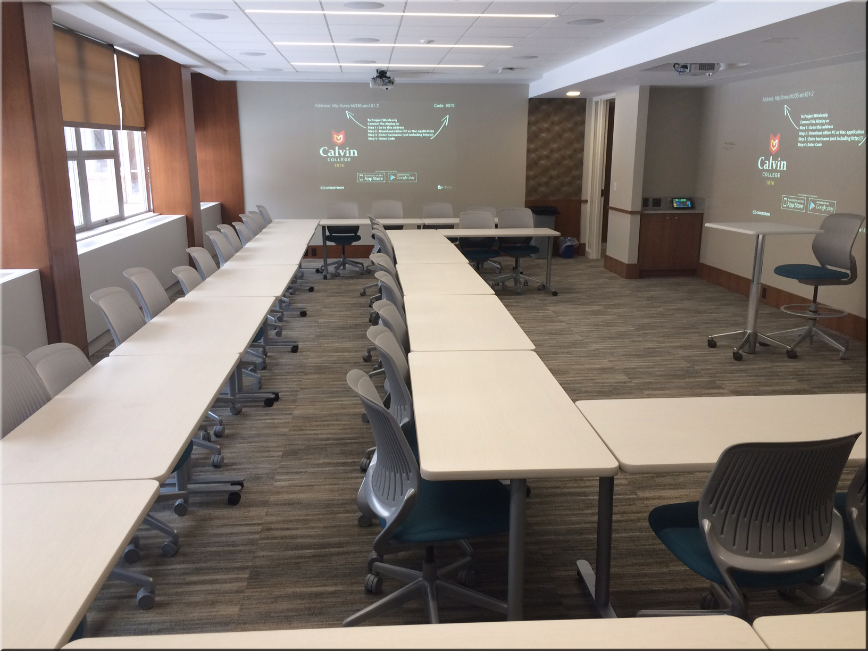
Lessons from the world of higher ed: Calvin
Learning spaces cost a lot of money to build or renovate!
Build ongoing maintenance funds into initial project costs
Building the right infrastructure requires a team-based approach
Notes:
May have launched if our group was on academic side of the house
2 presidents & 2 provosts missed the biggest thing to hit education in 500 years
Many faculty members against it

Slide 74
Lessons from the world of higher ed: Calvin
Launched a pilot of Calvin Online
13 courses developed with dual enrollment opportunities
Pilot died on the vine – never made it to the Faculty Senate Floor
May have launched if our group was on the academic side of the house
Top leadership – including the Boards – as well as many faculty members against online-based learning
NOTE: Years later, Calvin had to go online when the college became a university.
Notes:
May have launched if our group was on academic side of the house
2 presidents & 2 provosts missed the biggest thing to hit education in 500 years
Many faculty members against it

Slide 75
Lessons from higher ed: The importance of culture!
“Culture eats strategy for breakfast.” Cultures are critically important!
I didn’t understand this until Philip Morris acquired Kraft
The importance of culture was reinforced with Calvin Online
If you can do something new…
…it’s not just the “What are we doing?” But “How are we doing it?” and “Why are we doing it?”
Collaborative thinking helps uncover the possibilities
A reflection:
If the culture of your organization doesn’t support your or your group’s vision, perhaps it’s time to look for a better fit.

Slide 76
Something to reflect upon later on
Fodder for future reflection:
How would you describe the culture at your institution?
What are its views on emerging technologies? New programs? Curricular changes? Providing lifelong learning?
Are you and/or your group finding that the culture is working for you or does the culture need to change?
Bonus question:
How has Boeing’s culture hurt them recently?

Slide 77
Lessons from the world of higher ed: WMU Cooley Law School
The American Bar Association’s setup for legal education is ~20 years behind!
No 100%-online based programs
Small % of courses could be taken online
Online-based weekend programs saved our adult students major $$
ABA is NOT ready for today’s pace of change – our society is already being impacted (think AI)
In transitioning to two new major systems in one year:
Online-based documentation – training on demand – was critically important to our successful migrations

Slide 78
Lessons from the world of higher ed: WMU Cooley Law School
There are limits to how wide the gates of admission should be opened
One can’t change Bar Exam passage rates overnight
Trust your people and let them do the work they were hired to do
Be transparent as possible as an organization; as always, communications are key

Slide 79
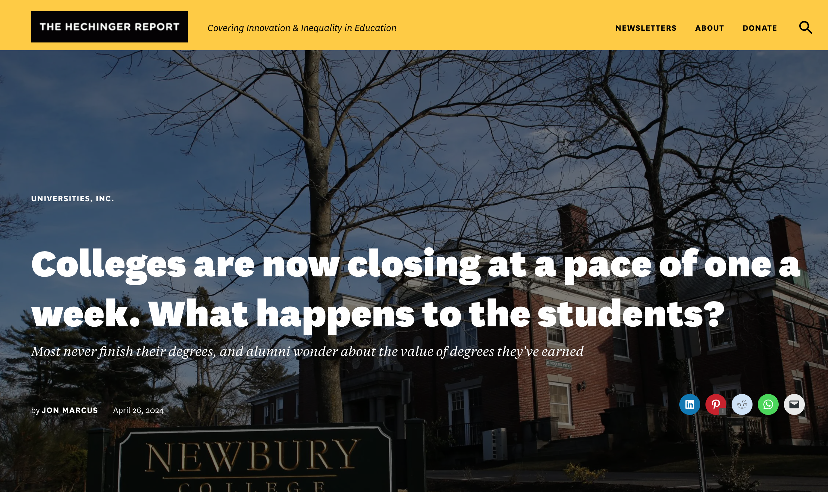
Lessons from the world of higher ed
Higher education needs to adapt!
Too costly & too much student debt
Difficult to keep the curriculum up-to-date
Students need solid jobs upon graduating
The business model is on its last legs
April 26, 2024
You can’t cut your way to success!

Slide 80
In conclusion
Some final questions to conclude this presentation:
What can you and your organization do to help people learn over a lifetime?
How can we offer our services as cost-effectively as possible?
How can we be more responsive to the needs that are out there?

Slide 81
Thank you for your time!
Daniel S. Christian
danielschristian.com DanielChristian55@gmail.com
X/Twitter: dchristian5 Linkedin.com: danielschristian
After this slide, see several people to check out re: EdTech & Learning Science

Slide 82
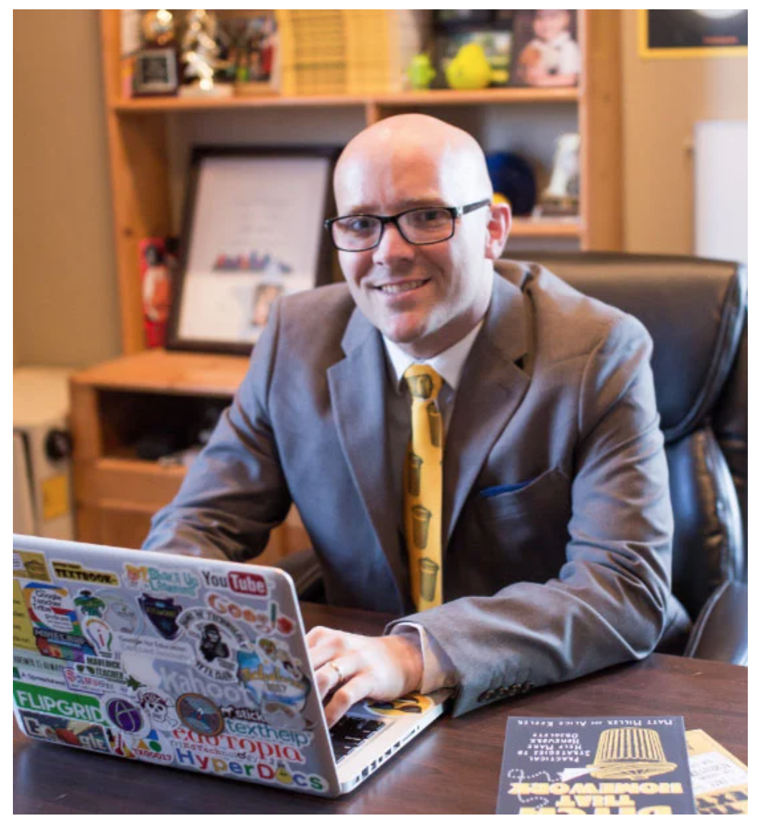
Some people/orgs to follow who are involved with learning
Donald Clark Plan B
50 blogs on learning theorists
Learning Theorists on his blog
Matthew Miller Ditch That Textbook

Slide 83
Some people/orgs to follow who are involved with learning
Connie Malamed
Donald Clark
50 blogs on learning theorists
Learning Theorists on his blog

Slide 84
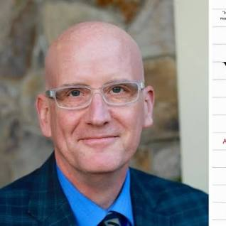
Some people to follow who are involved with learning
Eva Keiffenheim Twitter | The Learn Letter
Daniel T. Willingham

Slide 85
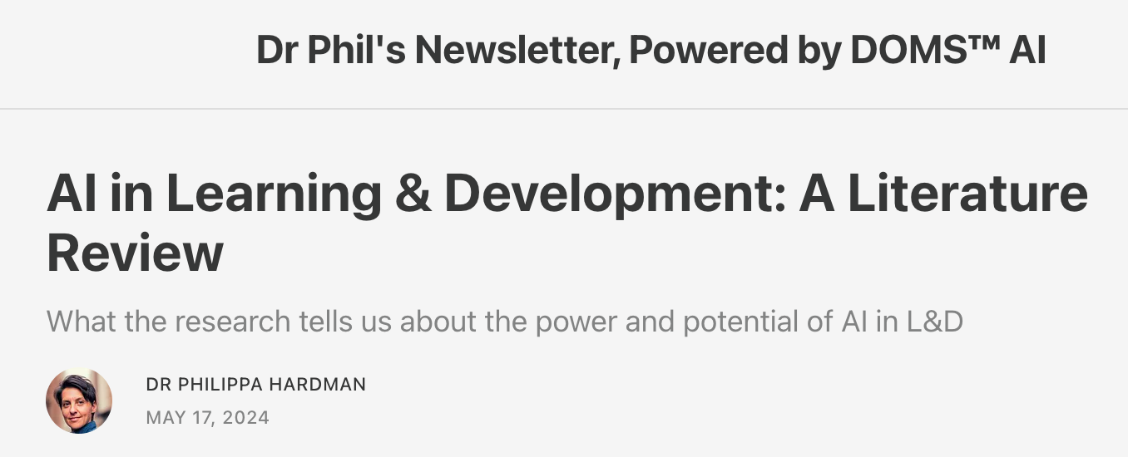
Some people to follow who are involved with learning
Dr. Philippa Hardman
Ideas & pedagogies
Science of learning
Learning Experience Design
Derek Bruff Agile Learning

Slide 86
Some people to follow who are involved with learning
Pooja Agarwal Retrieval Practice | Twitter

Slide 87
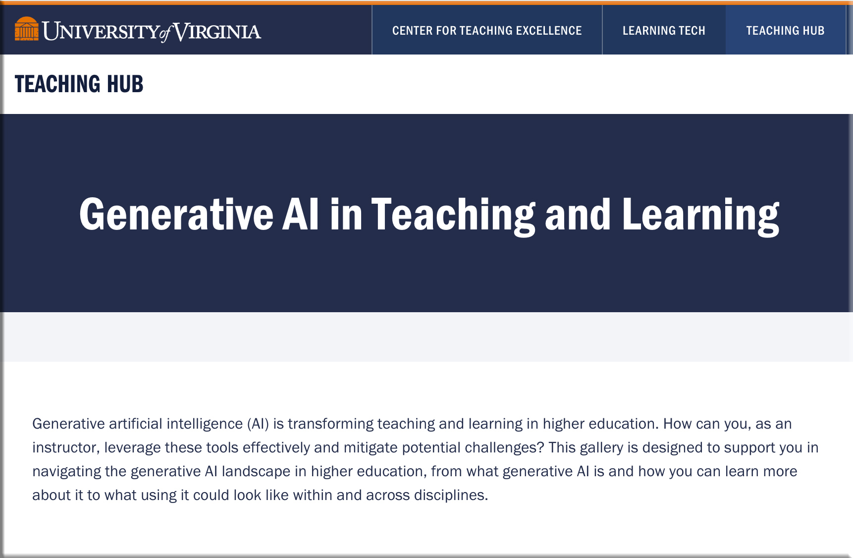
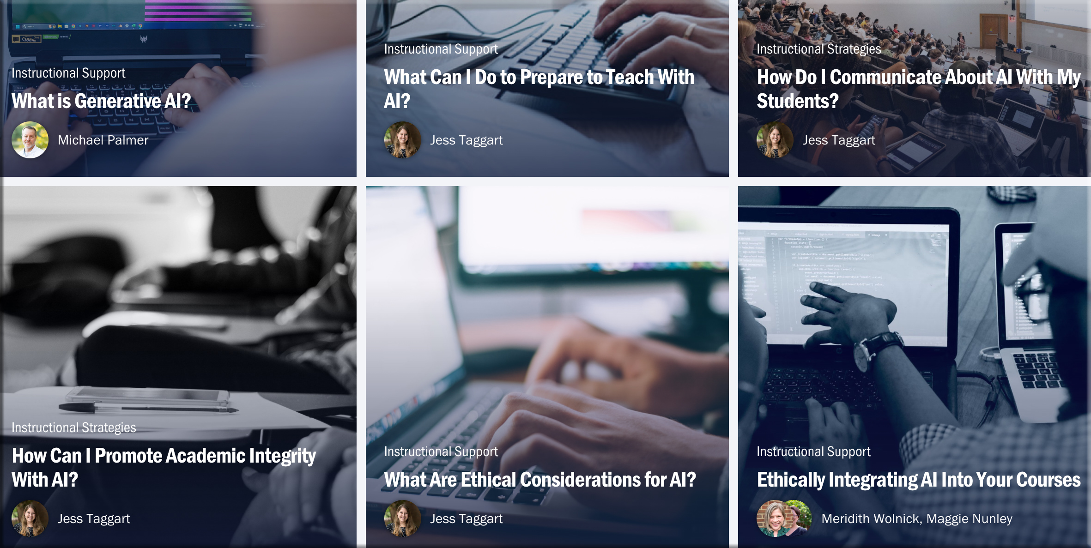
Some people/orgs to follow who are involved with learning
Per Derek Bruff:
U of VA’s Teaching Hub is designed to crowdsource the best teaching and learning resources around higher ed, resources useful for instructors, educational developers, & IDs
Journal articles, teaching guides, books, podcasts, and more

Slide 88
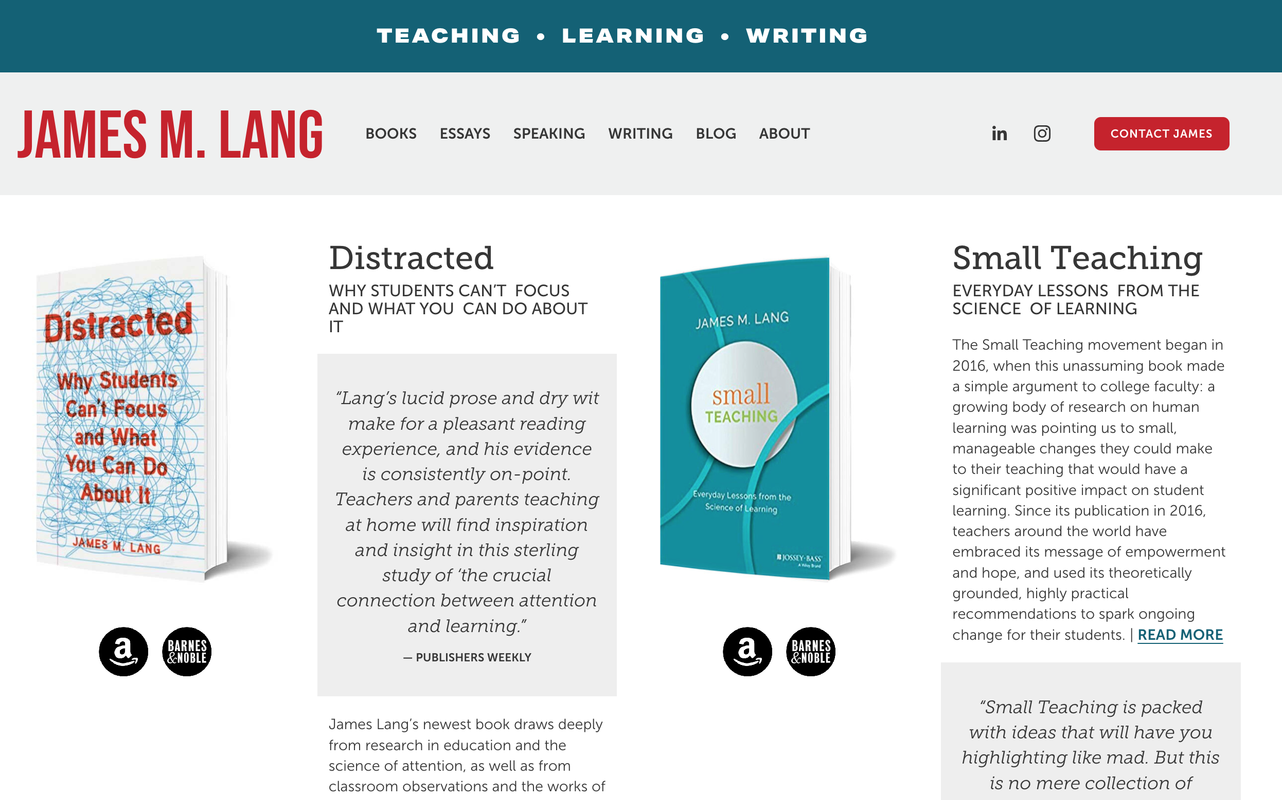
Some people to follow who are involved with learning
James Lang

Slide 89
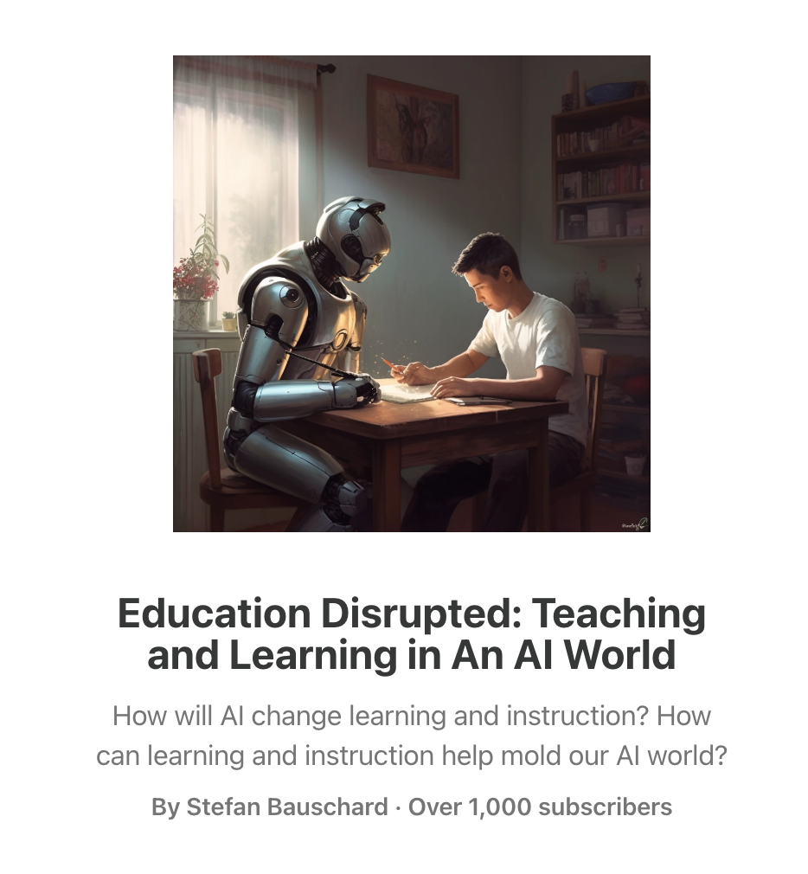
Some people to follow who are involved with EdTech
Stefan Bauschard
Education Disrupted: Teaching and Learning in An AI World

Slide 90
Some people to follow who are involved with EdTech
Dr. Alec Couros Twitter
Matthew Tower ETCH Weekend Reading

Slide 91
Some people to consider following [EdTech/ID]
George Veletsianos
Blog
5 Qs schools & universities should ask before they purchase AI tech products
Which educational problem does the product solve?
Is there evidence that a product works?
Did educators and students help develop the product?
What educational beliefs shape this product?
Does the product level the playing field?

Slide 92
I’m excited about LegalTech, because we have a major problem
The Making of the Access to Justice (A2J) Crisis – Stanford Law Review
“…the civil justice system is in crisis.”
In ~¾’s of the 20M civil cases filed in state courts each year, 1 side lacks a lawyer
But tens of millions more Americans face genuine legal problems but take no formal legal action to protect their interests

Slide 93
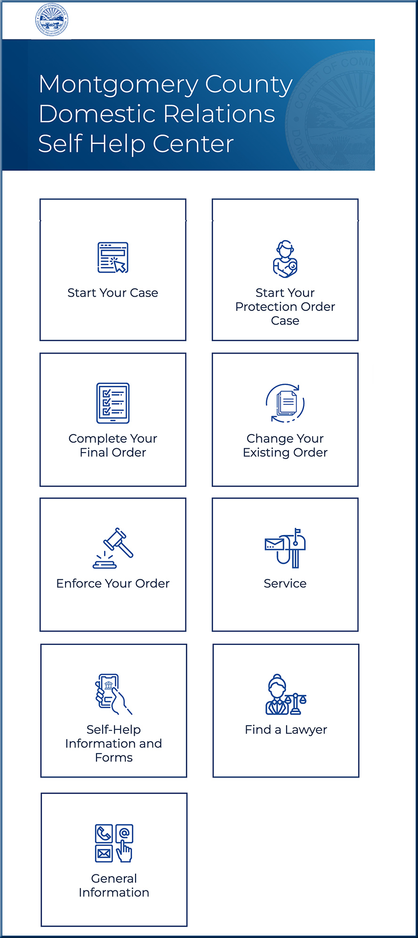
Q to ponder: Which techs are you excited about & why?
I’m hopeful that LegalTech can…
I’m hopeful that LegalTech & more self-help types of services can increase Access to Justice (A2J) while reducing costs. I hope that we can:
Enhance our ability to serve justice
Increase access to legal services
Improve the quality of firms’ work
Automate mundane tasks
I’m not crazy about finding which judge is most advantageous to your case (via analytics).

